Slide 1

Mortgage is changing…

Slide 2
The mortgage is becoming a commodity

Slide 3
1. Lowest Price
2. Fastest Response
3. Least Friction

Slide 4
Faster
Cheaper
Simpler

Slide 5
The race is won at intake

Slide 6
Responds first
Locks first
Closes first

Slide 7
Mortgage was never designed for this kind of speed

Slide 8
Infrastructure can’t support market

Slide 9
Mortgage lending has reached this moment…

Slide 10
Reviewed…
Touched…
Handed off…
Reworked…
Reconciled…
Checked again…

Slide 11
The loan only moves when someone pushes it…

Slide 12
Emails…
Calls…
Constant back & forth…

Slide 13
When volume goes up

Slide 14
Work goes up

Slide 15
Speed drops

Slide 16
Cost per loan rises

Slide 17
Slower. More Expensive.

Slide 18
This is not a
“features” problem

Slide 19
This is a system problem

Slide 20
This is the reality…

Slide 21
Stop adding tools

Slide 22
Platforms on rebuilt infrastructure

Slide 23
This isn’t new

Slide 24
Amazon
Stripe
Salesforce

Slide 25
Rebuilding the system behind the work

Slide 26
Platforms fundamentally change how work moves

Slide 27
The loan shouldn’t wait…

Slide 28
The loan should move itself forward

Slide 29
Time shouldn’t be spent chasing files…

Slide 30
It should be spent making decisions about the loan

Slide 31
That’s what we’ve been building…

Slide 32
Redesigned infrastructure

Slide 33
Point
Zip
Path
Zenly
LoanScorecard

Slide 34
One system coordinating the full loan lifecycle

Slide 35

Notes:
Now—to be clear—this isn’t a big rebrand.
The products you know are still the products you know.
What’s changing… is how we think about them.
This isn’t a bunch of tools anymore.
This is one system working together.
And going forward, we’re aligning everything around a single goal…

Slide 36
Increase speed
Lower cost
Remove friction

Slide 37
Reduce the work it takes to move a loan

Slide 38
Borrowers
Lenders
✓ Fewer document requests
✓ Lower cost per loan
✓ Faster approvals
✓ Shorter cycle times
✓ Clearer status
✓ Less operational overhead
Brokers/LOs
Vendors/Investors
✓ Less time chasing conditions
✓ Integrate once
✓ Fewer status calls
✓ Cleaner data
✓ More time to get leads & originate loans
✓ Faster delivery
✓ Reach ecosystem through platform

Slide 39
Less coordination
Fewer touches
Less rework

Slide 40
This is what the next era of mortgage looks like

Slide 41

Let's make this real...

Slide 42



Slide 43
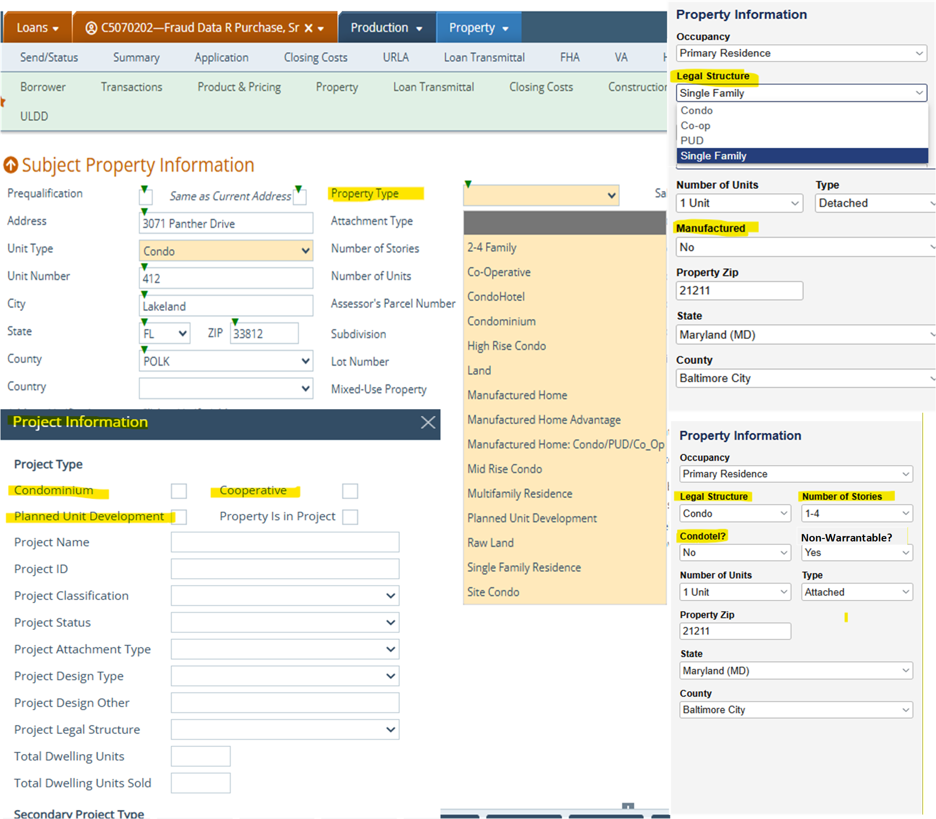

Slide 44
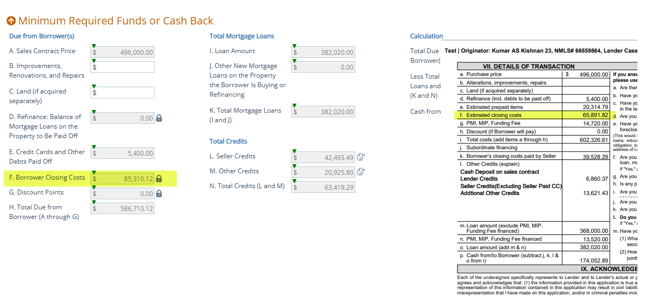

Slide 45
Logic
If LoanPurposeType="Refinance" and RefianceCashoutDeterminationType ="CashOut" Then RefiCashout
If LoanPurposeType="Refinance" and RefianceCashoutDeterminationType =" LimitedCashOut" Then RefiRateTermLimitedCO
If LoanPurposeType="Refinance" && RefinancePrimaryPurposeType=="InterestRateReductionRefinanceLoan" && MortgageType =="Conventional" Then RefiRateTermLimitedCO
If LoanPurposeType="Refinance" && GovernmentRefinanceType=="InterestRateReductionRefinanceLoan" && MortgageType =="USDA ||FHA" then RefiRateTermLimitedCO
If LoanPurposeType="Refinance" && GovernmentRefinanceType=="InterestRateReductionRefinanceLoan" && MortgageType =="VA" Then VARateReduction
If LoanPurposeType="Refinance" && GovernmentRefinanceType=="StreamlineWithoutAppraisal" && MortgageType =="FHA" then FHAStreamlineRefi
if LoanPurposeType="Purchase" then Purchase
if LoanPurposeType="Other" && LoanPurposeTypeOtherDescription="HELOC" then RefiCashout
If LoanPurposeType== Other && LoanPurposeTypeOtherDescription = "ConstructionOnly || Construction-Pem"
match with ConstructionLoanPurposeType
"Purchase" : Purchase
"Refinance" : "RefiRateTermLimitedCO"
If LoanPurposeType ="Other " & LoanPurposeTypeOtherDescription ="Home Equity Loan" Then RefiCashout

Slide 46
Field: Property Type
Translation across systems
Path | AUS | Compliance | Appraisal | Pricing | DOCS
Condominium Planned Unit Development Planned Unit Development-Attached Co-Operative Mid Rise Condo High Rise Condo Manufactured Home Manufactured Home: Condo/PUD/Co_Op Manufactured Home Advantage Single Family Residence Multifamily Residence Modular CondoHotel 2 – 4 Family Site Condo Land Raw Land | ConstructionMethodType ProjectLegalStructureType AttachmentType ProjectDesign Type | Attached Condominium Cooperative Detached HighRiseCondominium ManufacturedHousing Other PUD | Attached Condominium Cooperative Detached Planned Unit Development Manufactured Home Modular Home Single Family Multi Family Condotel VacantLand 2 to 4 Unit Building | SingleFamily NonWarrantableCondo Condo Condotel ManufacturedSingleWide ManufacturedDoubleWide Modular PUD Coop Townhouse | Condominium Cooperative LandAndLots ManufacturedHome ManufacturedHomeCondominium ManufacturedHomePUD OneToFourFamily PUD SingleFamily
Notes:
This is what causes most of the effort in the mortgage process because the translations here get adjusted to the loan in the LOS and things start to go haywire and need to be checked and rechecked and fixed and worked backwards. Path solves this by keeping the state of the original loan and checking integrations against that state. If something is off in that process, the loan doesn not move forward until fixed. So nothing gets spotted late and the loan only moves forward when it’s correct.

Slide 47
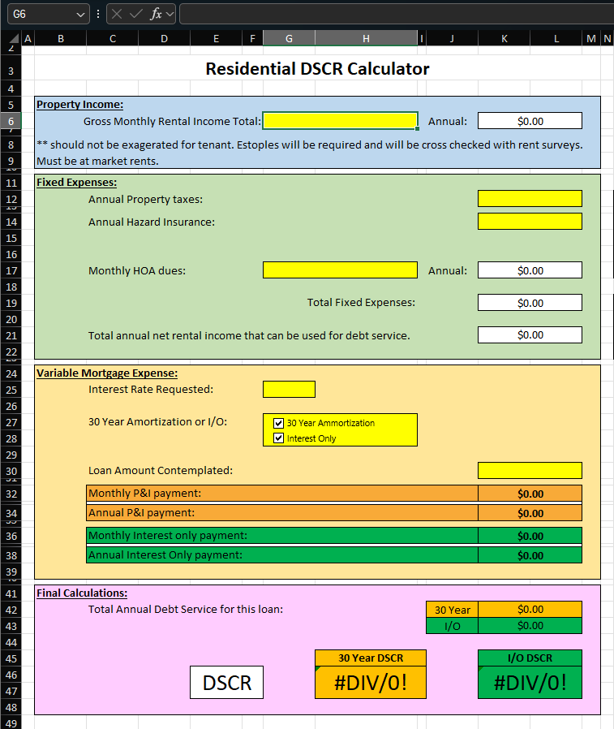

Slide 48
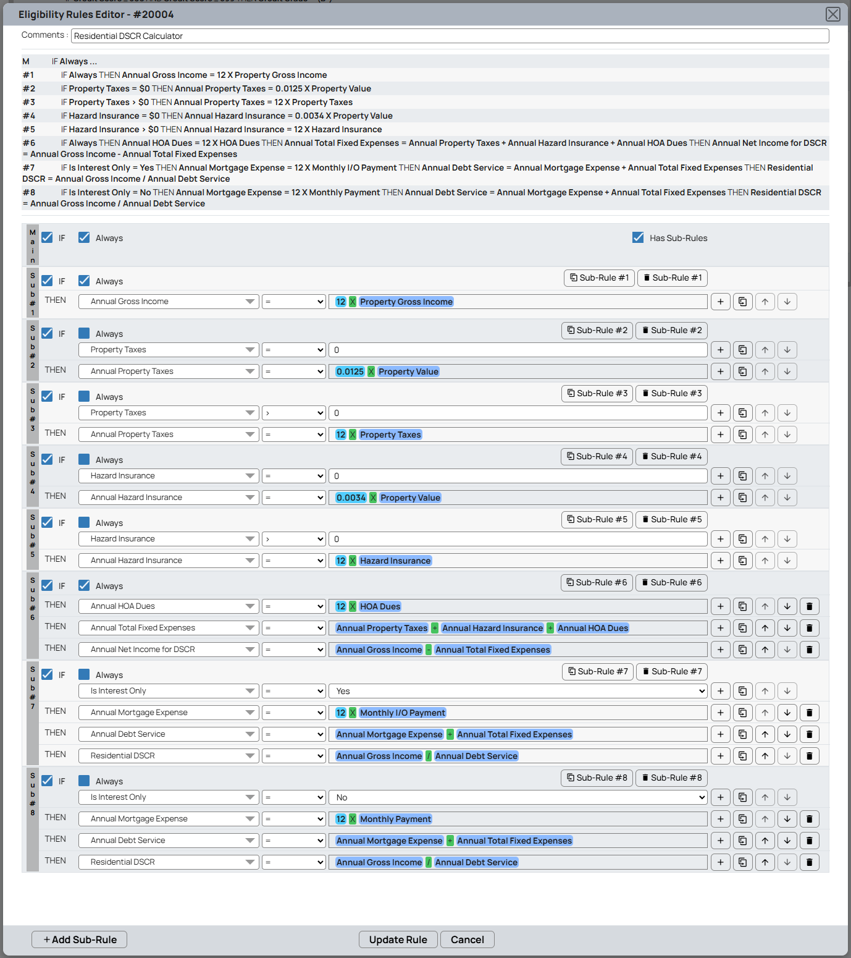

Slide 49
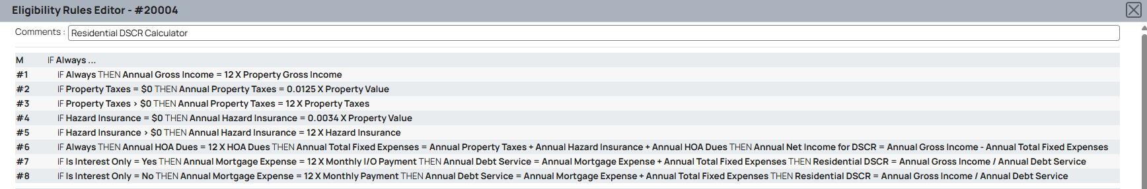

Slide 50
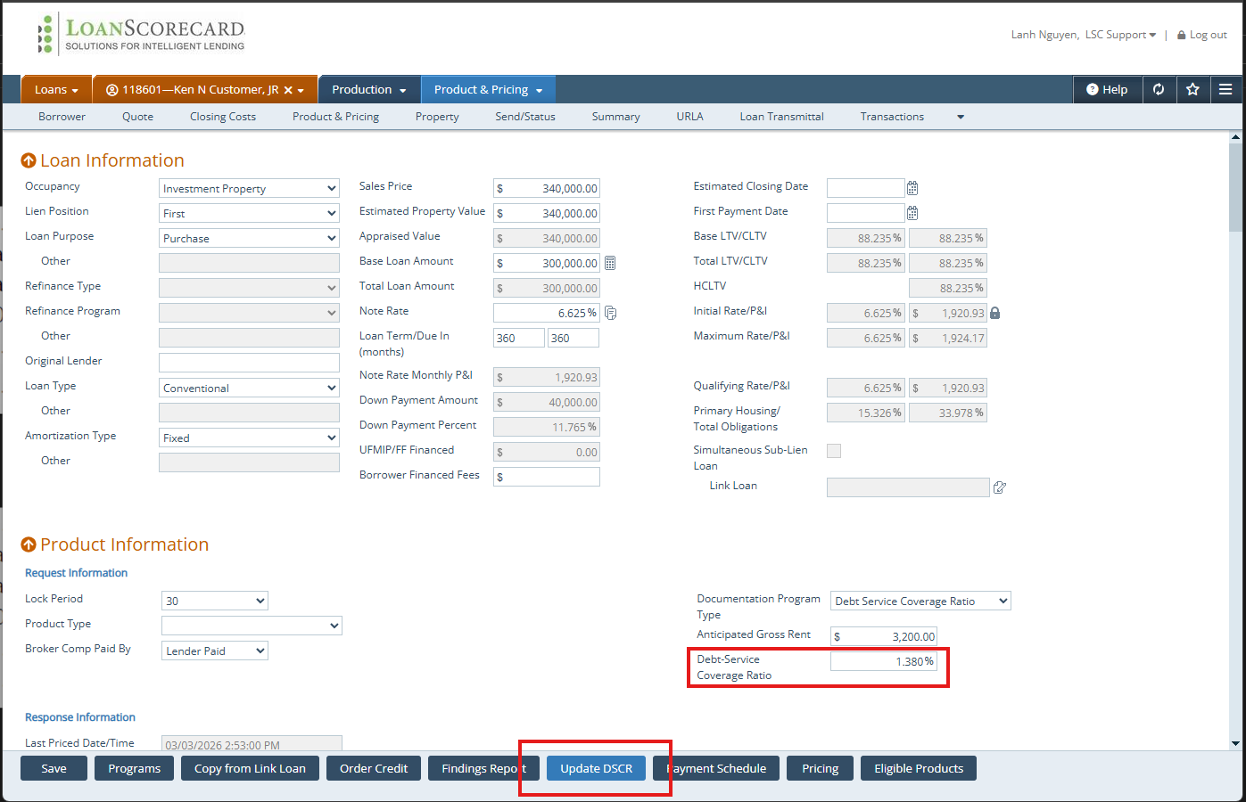

Slide 51
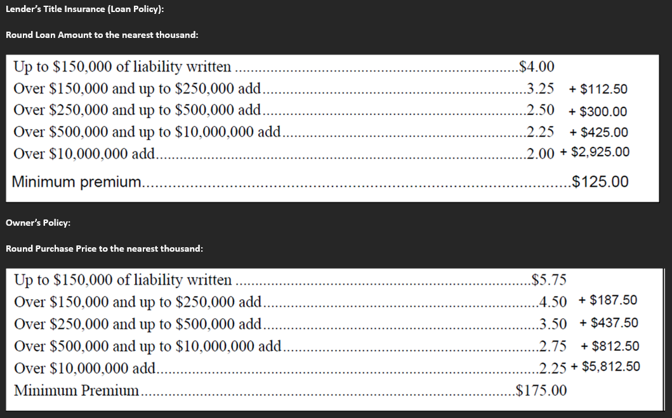

Slide 52
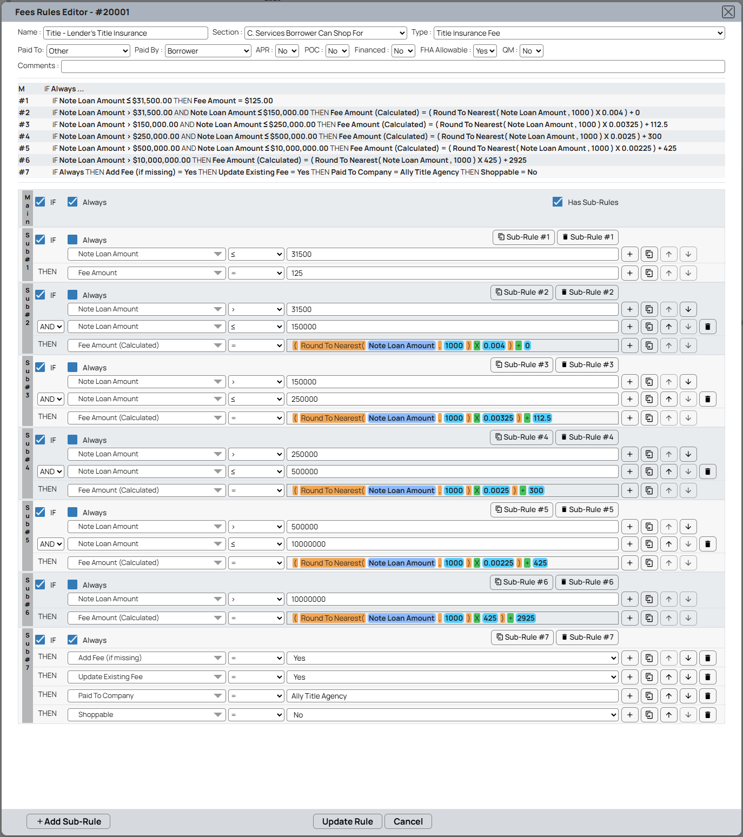

Slide 53
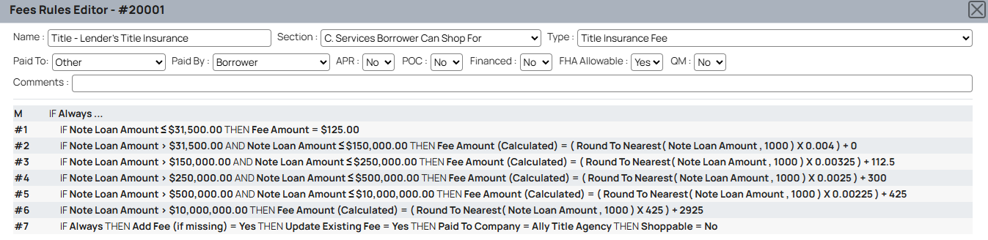

Slide 54
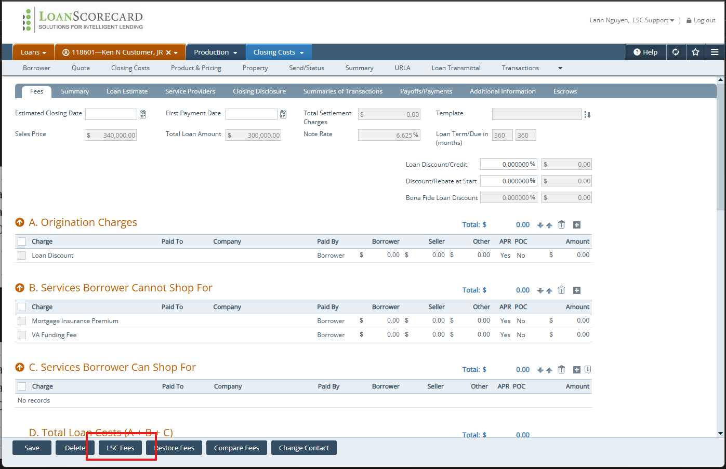

Slide 55
3rd Party
System
Submission
Calyx TPO
Decisioning Engine
Calyx
60k Brokers
Intake
POS/Zenly
Visibility

Slide 56
Field: Property Type
Translation across systems
Path | AUS | Compliance | Appraisal | Pricing | DOCS
Condominium Planned Unit Development Planned Unit Development-Attached Co-Operative Mid Rise Condo High Rise Condo Manufactured Home Manufactured Home: Condo/PUD/Co_Op Manufactured Home Advantage Single Family Residence Multifamily Residence Modular CondoHotel 2 – 4 Family Site Condo Land Raw Land | ConstructionMethodType ProjectLegalStructureType AttachmentType ProjectDesign Type | Attached Condominium Cooperative Detached HighRiseCondominium ManufacturedHousing Other PUD | Attached Condominium Cooperative Detached Planned Unit Development Manufactured Home Modular Home Single Family Multi Family Condotel VacantLand 2 to 4 Unit Building | SingleFamily NonWarrantableCondo Condo Condotel ManufacturedSingleWide ManufacturedDoubleWide Modular PUD Coop Townhouse | Condominium Cooperative LandAndLots ManufacturedHome ManufacturedHomeCondominium ManufacturedHomePUD OneToFourFamily PUD SingleFamily
Notes:
This is what causes most of the effort in the mortgage process because the translations here get adjusted to the loan in the LOS and things start to go haywire and need to be checked and rechecked and fixed and worked backwards. Path solves this by keeping the state of the original loan and checking integrations against that state. If something is off in that process, the loan doesn not move forward until fixed. So nothing gets spotted late and the loan only moves forward when it’s correct.

Slide 57
Single Shared Data Model
The loan moves itself forward
3rd Party
System
Submission
Calyx TPO
Decisioning Engine
Calyx
60k Brokers
Intake
POS/Zenly
Visibility

