Slide 1
Managing Growth at scale
Measure What You Manage.
Steven Garcia

Slide 2

Legal Disclaimer
The information presented herein is confidential and proprietary to Calyx Technology Inc., doing business as Calyx Software (“Calyx”), and may not be disclosed without the prior written consent of Calyx.
This presentation is intended solely to provide general information and does not constitute legal, financial, or other professional advice or opinion. The content is believed to be accurate as of the date of presentation; however, Calyx makes no representations or warranties regarding its completeness or accuracy.
Any examples included are for illustrative purposes only. Any resemblance to actual persons, entities, places, or events is purely coincidental and unintentional. Such examples are not intended to serve as legal advice or guidance.
No part of this presentation may be reproduced, modified, distributed, printed, or publicly displayed without the prior written permission of Calyx.

Slide 3
Agenda
01 | The Visibility Problem Created by Growth
02 | From Data to Control: The Visibility Model
03 | The Reporting System (How It All Connects)
04 | Core Reports That Drive Action
05 | Demo

Slide 4

The Challenge: Visibility Creates Control
Growth doesn’t create chaos – lack of visibility does.
More loans → less control
More LOs → inconsistent performance
More branches → different processes
Data exists… but it’s not being used to manage growth.
Notes:
“You don’t lose control when business is slow. You lose it when you grow. More loans. More people. More moving parts.
And suddenly—you’re not managing the business anymore… you’re reacting to it

Slide 5
Business Cases
Business Case 1: Local Bank
Business Case 2: Wholesale AE
Grew quickly
Acquired multiple branches
2 systems
2 cultures
Bank
IMBs
Valued metric pull - through
Culture of profitability
Valued metric plus systems to make tough decisions

Slide 6

The Solution:
We can only scale what we can see
Track → Monitor → Report → Act → Grow
Tracking = capture clean, connected loan data.
Monitoring = surface issue early, before they become problems
Reporting = turn data into clear visibility
Action = drive accountability and execution
Action Grows Your Business
Notes:
These reports are built to move you from seeing → monitoring - to managing → to improving.”

Slide 7
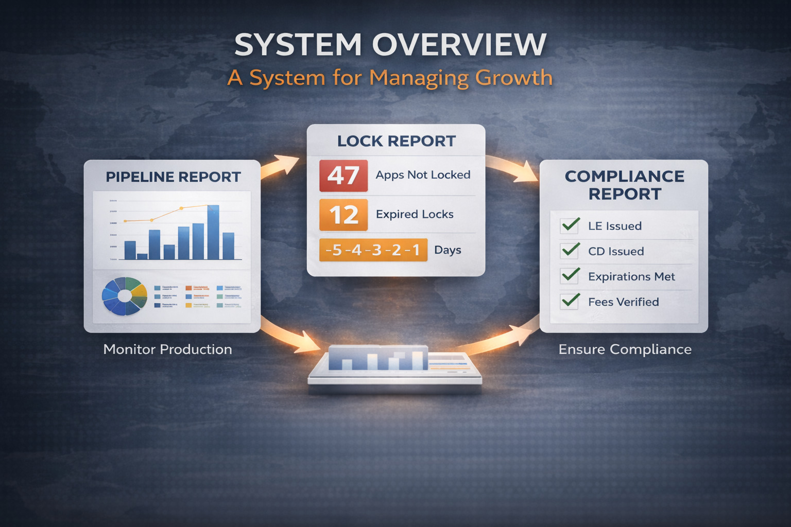
System Overview – A System for Managing Growth
Pipeline Report
Volume + Distribution + aging and ownership
Lock Report
Tracks Revenue Execution
Compliance Report
Addresses Risk + Timing
Integrated System
Together, these reports enable Operational Control
Notes:
Systems to promote Scale. “This isn’t three reports. This is a system: Pipeline tells you what’s coming Lock tells you if you’re converting Compliance tells you where you’re exposed If one breaks—you lose revenue.”

Slide 8

Pipeline: Where Growth Begins
Pipeline: Visibility into what’s coming
  Compare by BU, role, loan type
  Identify status
  Track assignment and aging
  Drill down to loan-level details
  Historical reporting
“Most lenders don’t have a growth problem… they have a visibility problem. - Bob Havren”
Notes:
“Most lenders don’t have a growth problem… they have a visibility problem.”
16 loans sitting as “New Loan”
16 apps not locked
16 expired LE timing violations
👉 That’s not data. That’s revenue leakage

Slide 9

Lock Report:
Where Revenue is Won or Lost
Not Locked → missed opportunity
Expired Locks → lost revenue
Lock Expiration tracking (1-5 days out)
Proactive pipeline protection
Catch revenue leakage before it happens.

Slide 10

Compliance Report
Prevention Monitoring:
  LE Not Issued
  Expired
  Fees Changed
  CD Not Issued

Slide 11
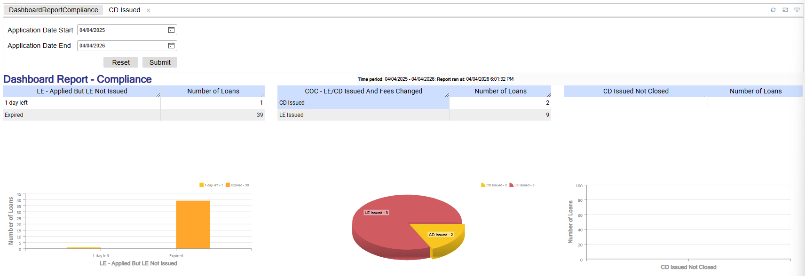
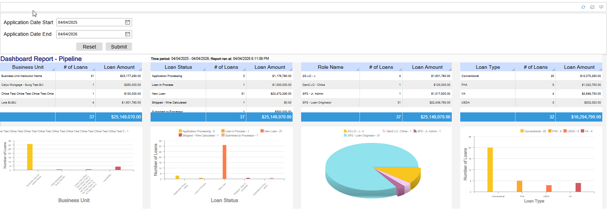
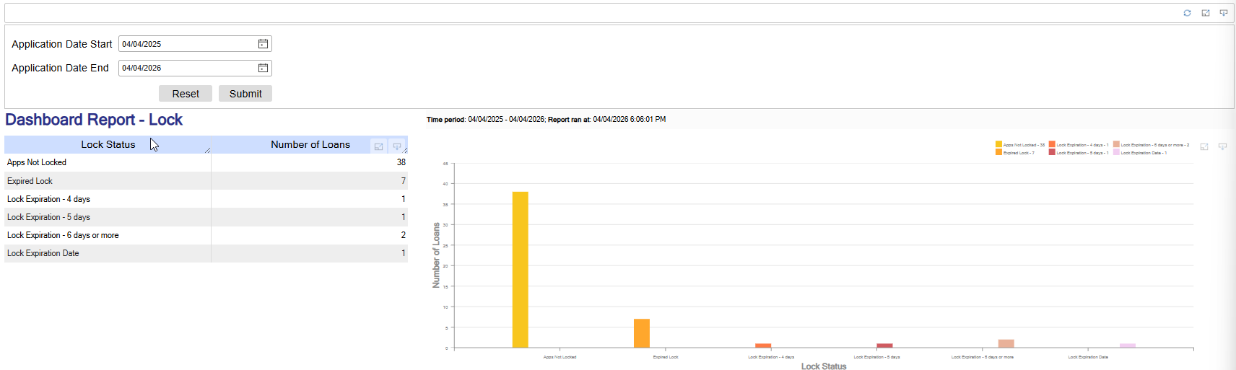
DEMO

Slide 12
Your Suite of Features
Dynamic, real-time data
Drill-down to loan level
Filter by role, BU and or status
Export with full details to Excel
Montor performance and risk

Slide 13
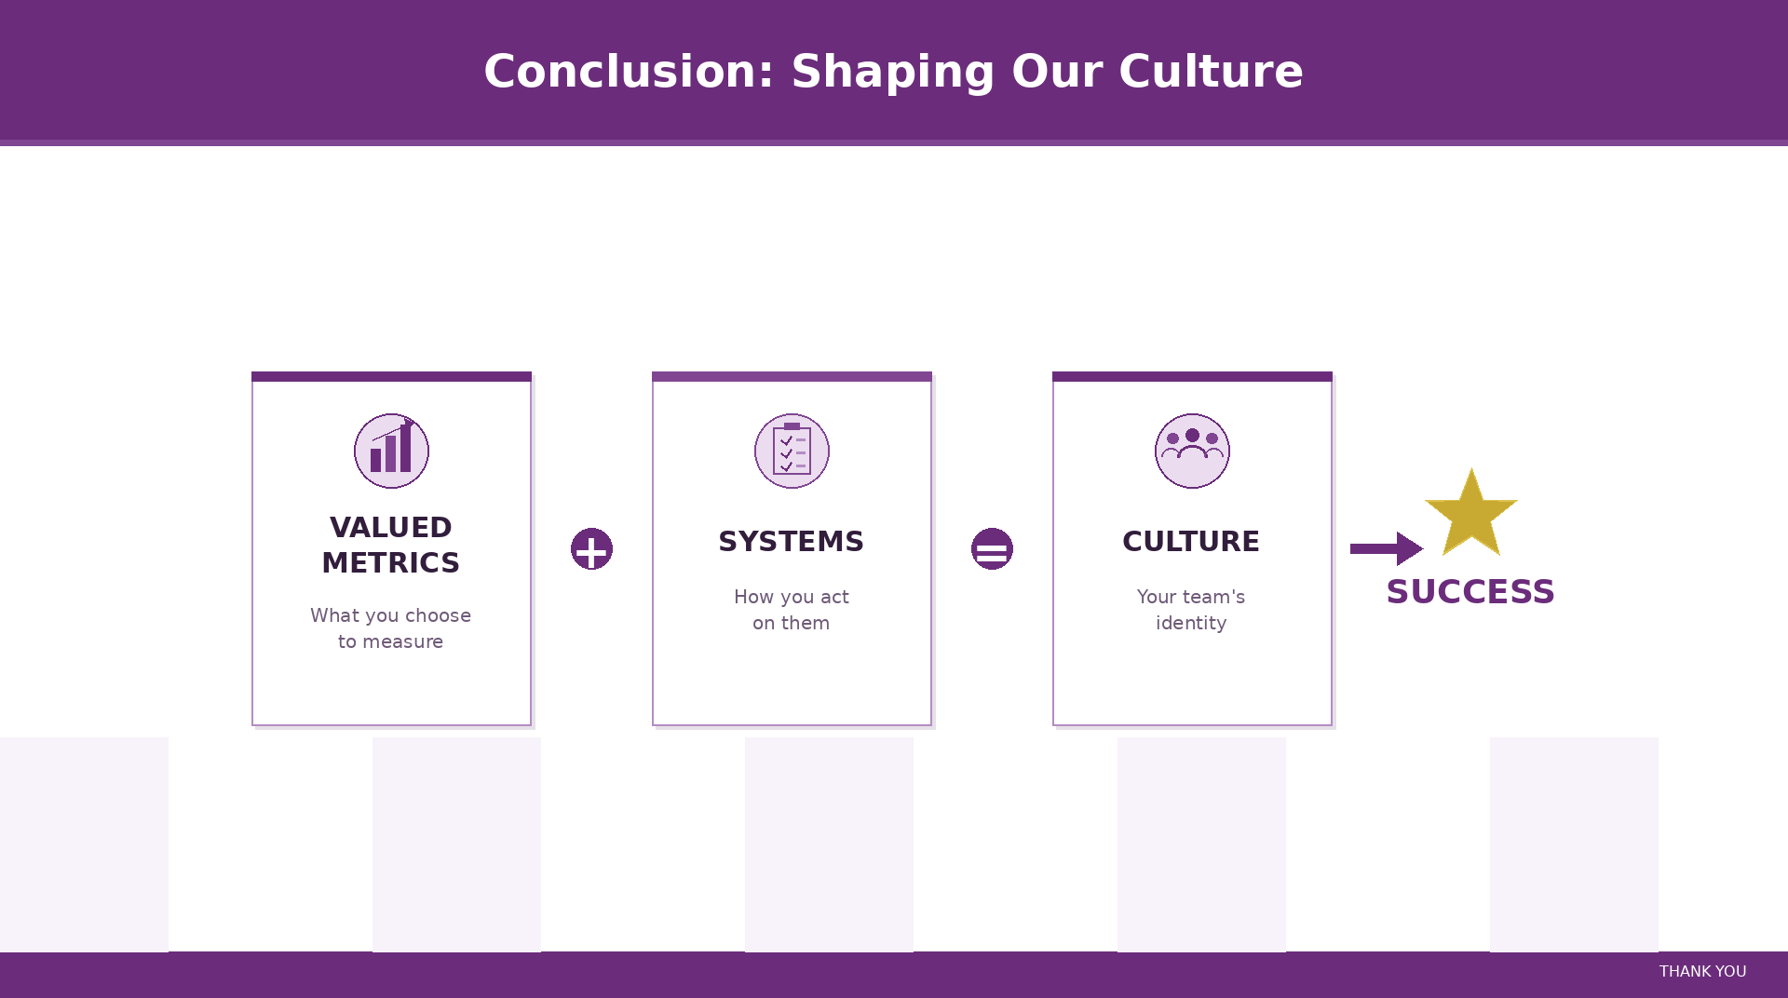

Slide 14


THANK YOU
Steven Garcia
866-302-2599
Steven_garcia@calyxsoftware.com
www.pathsoftware.com

