Slide 1

Turning your marketing
Strategy into Execution within Path
Wendy Cloud

Slide 2
How Many of you are asking
Why did Lyndsay go over
How to be Unforgettable with Marketing?

Slide 3

MARKETING
BUILT IN PATH
POWERED BY ADUVO

Slide 4
Why is this so
Powerful?
Marketing connection directly
in your loans!
Marketing connection directly
in your loans!

Slide 5
Show You
How this will work

Slide 6





New Application Journey
Realtor calls with a NEW LEAD!
You call the new lead, you get to know them & learn what their goals are, explain how they can apply online
Couple completes application
You receive a notification from PATH that their application is complete

Slide 7
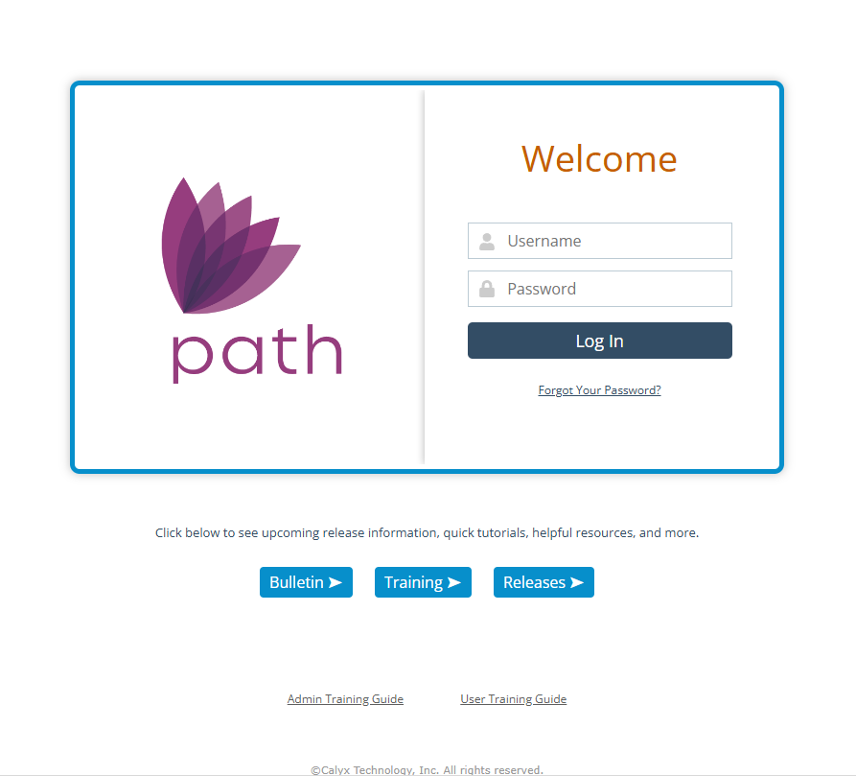
Log in Path

Slide 8
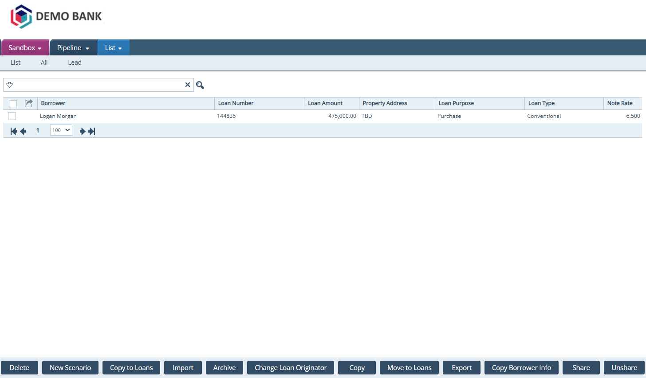

Go into their Loan

Slide 9
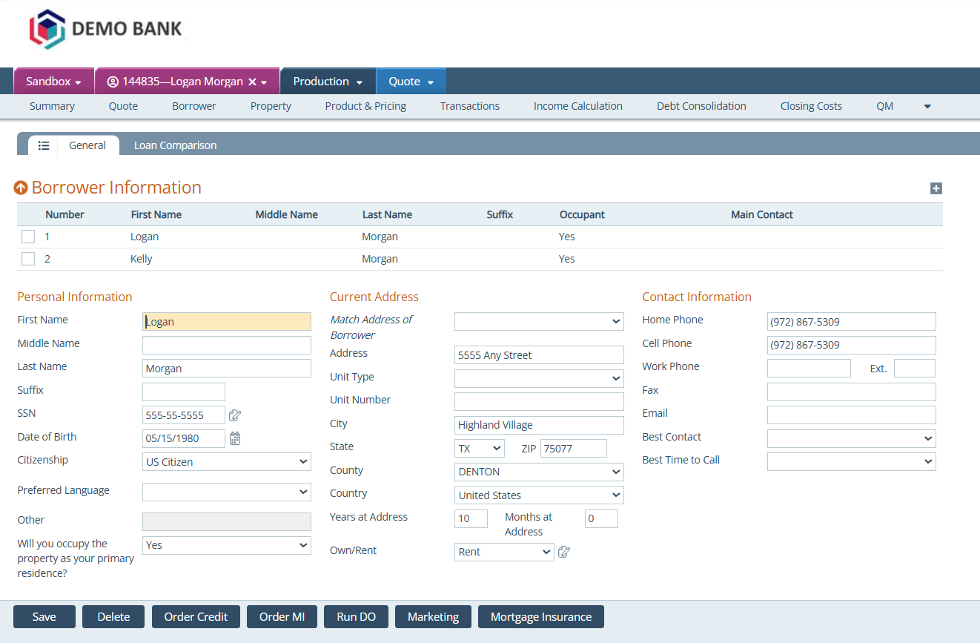
Quote Screen

Slide 10
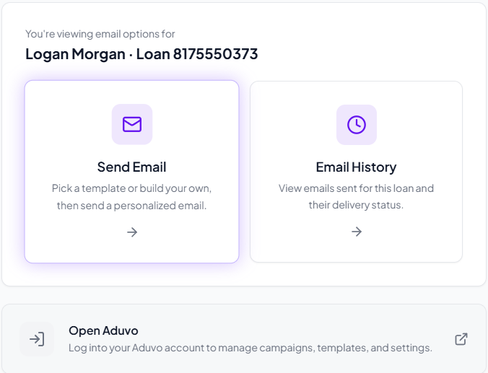

Slide 11
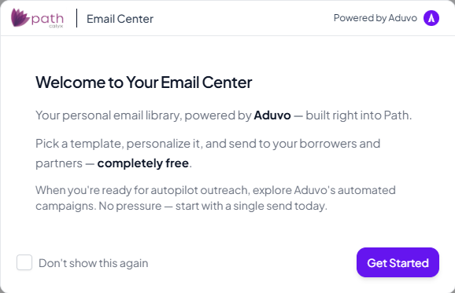

Slide 12
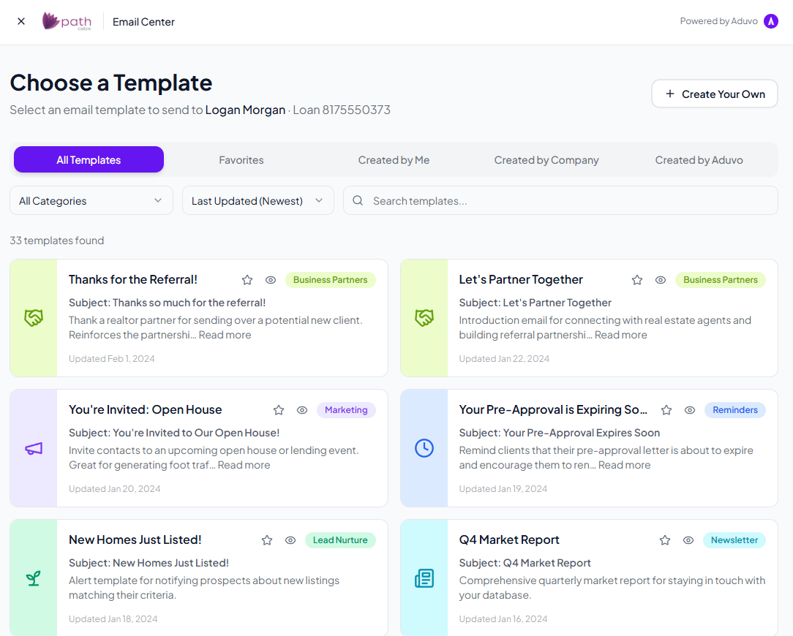

Slide 13
BEGIN WITH
Pre-built
Email template

Slide 14
Wait!!
How do I Get My
contact information
In the system

Slide 15
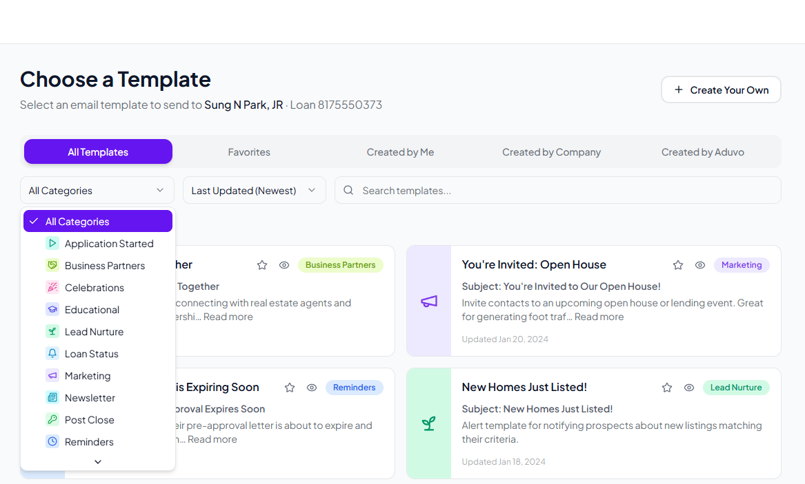





Slide 16
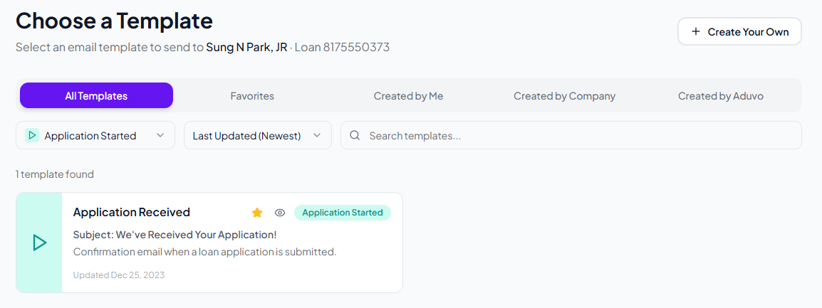

Slide 17
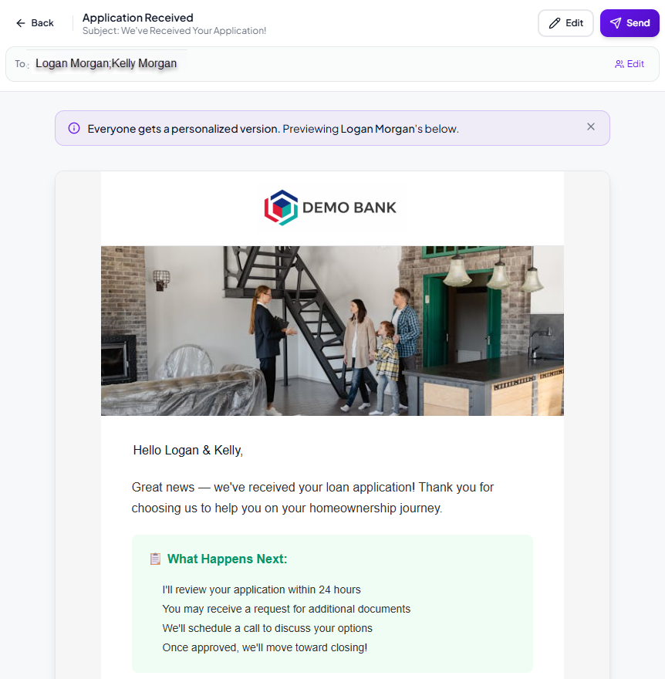

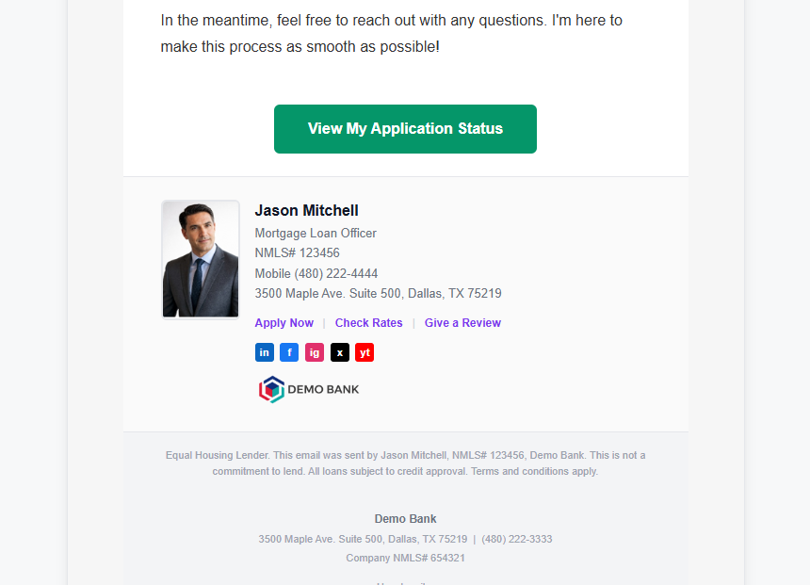
Review
Email
Edit
Email

Slide 18
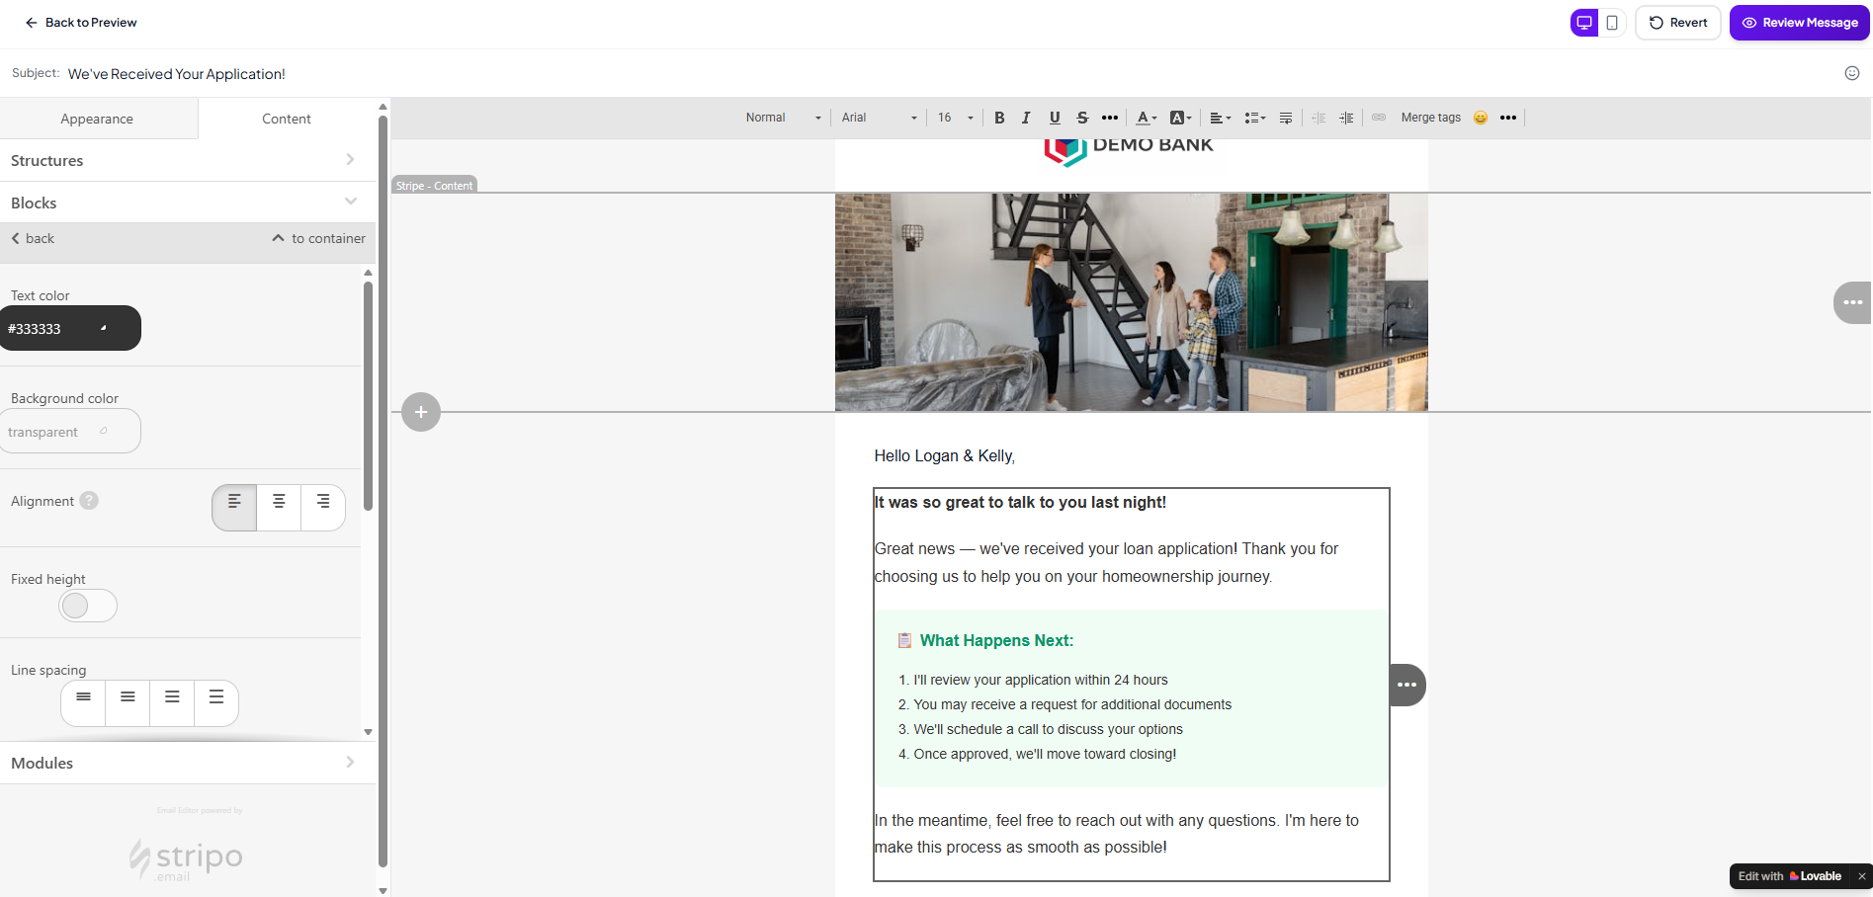


Edit Email

Slide 19
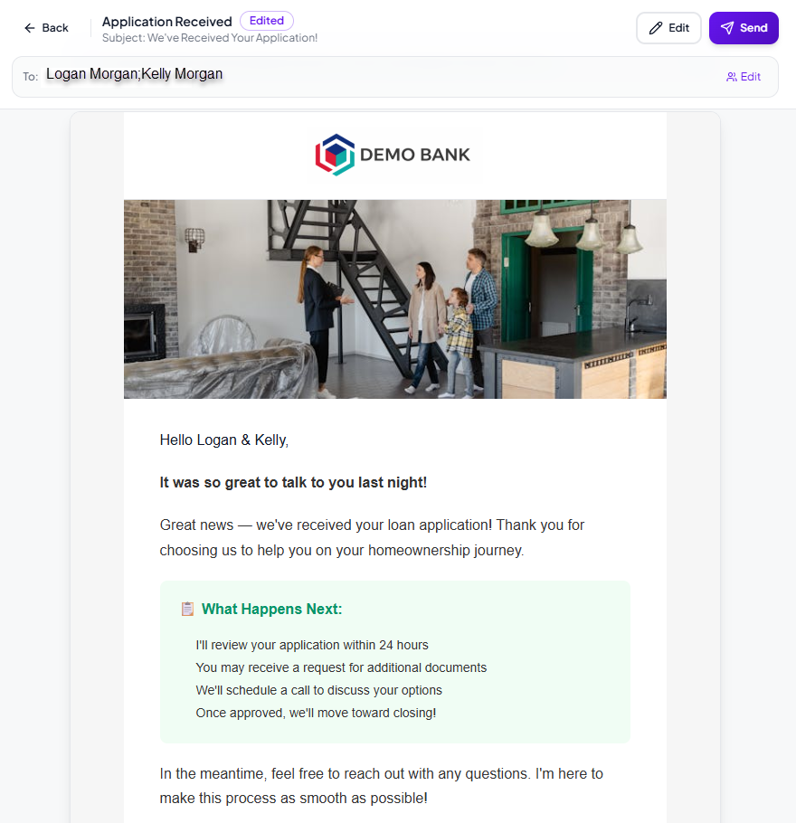
Review
Send Email

Slide 20
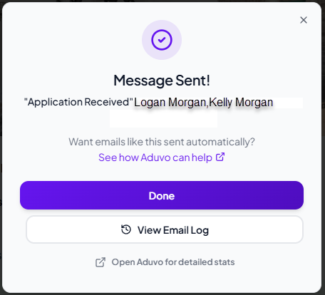


Slide 23
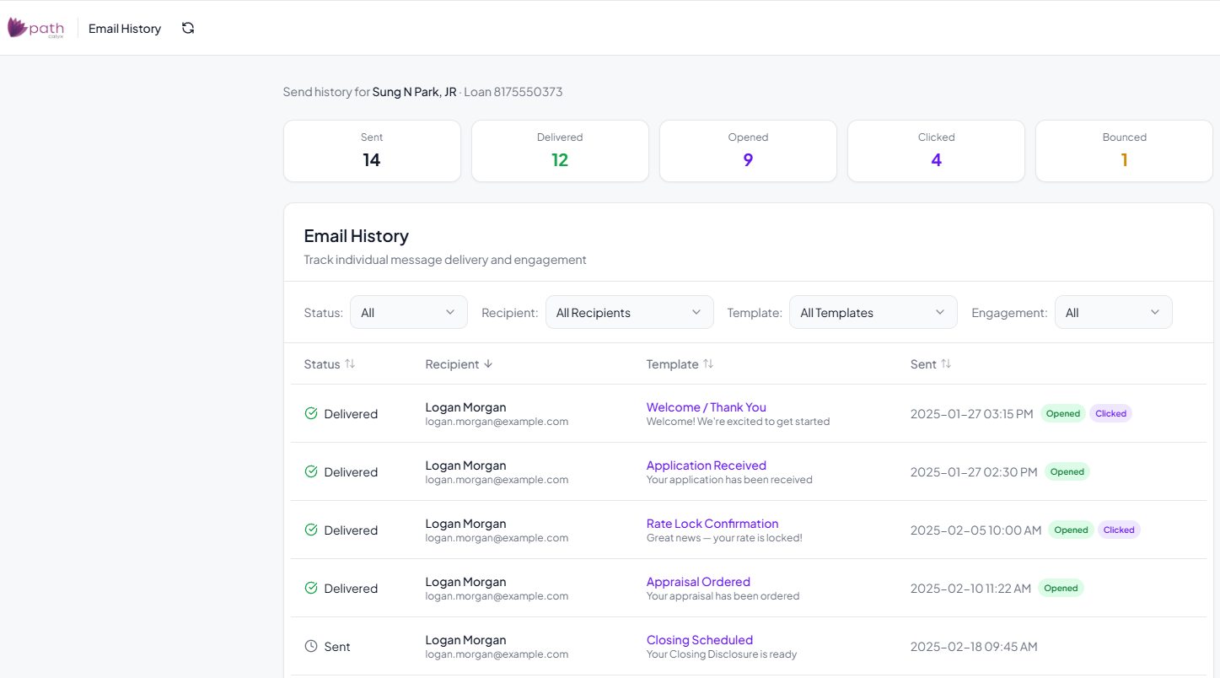
Email History

Slide 24
Send
Thank you
Email to agent

Slide 25
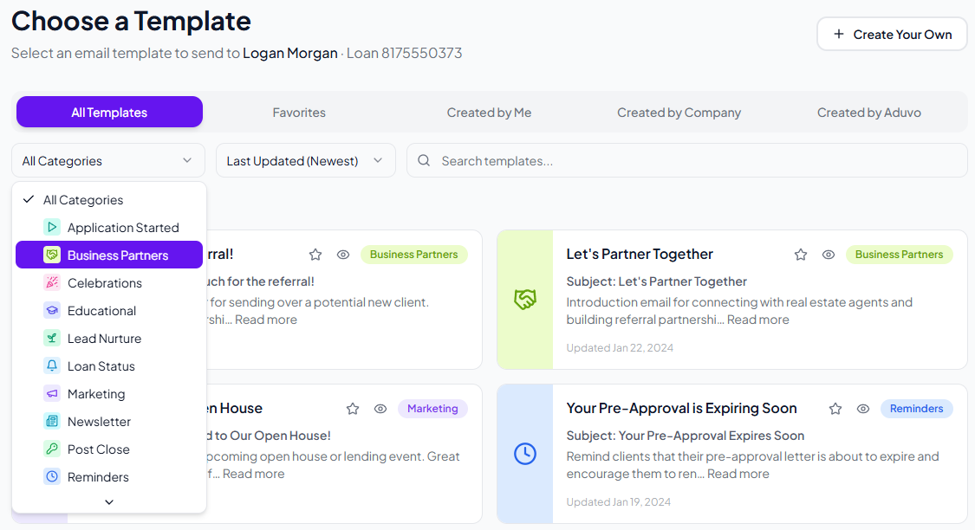
Send Thank You Email to Agent

Slide 26
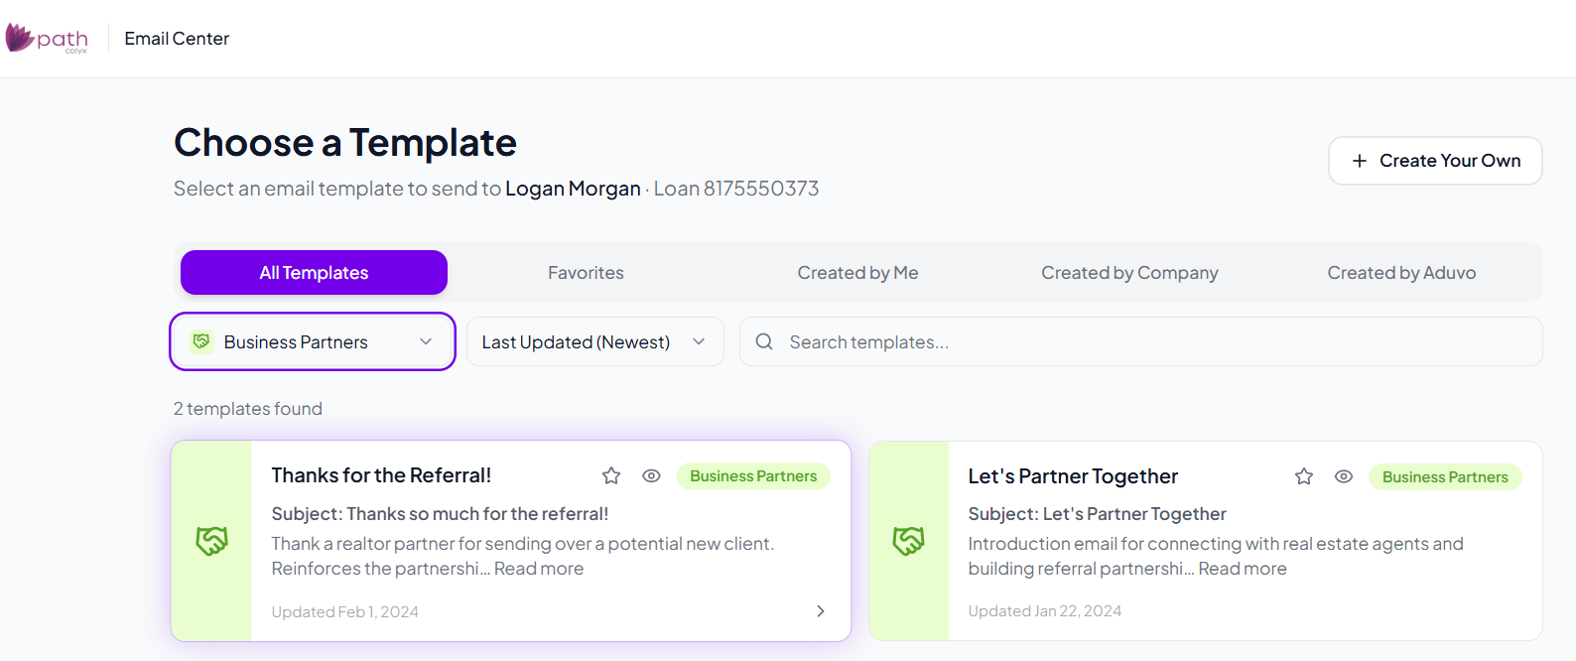
Thanks for the Referral! Touch Point

Slide 27
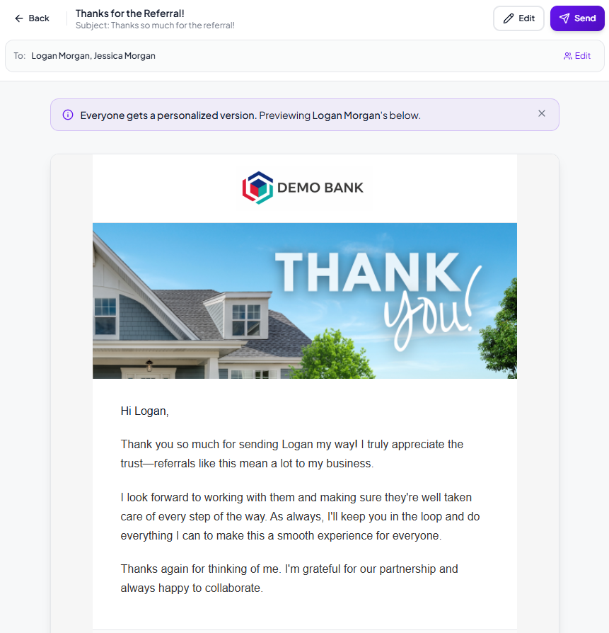

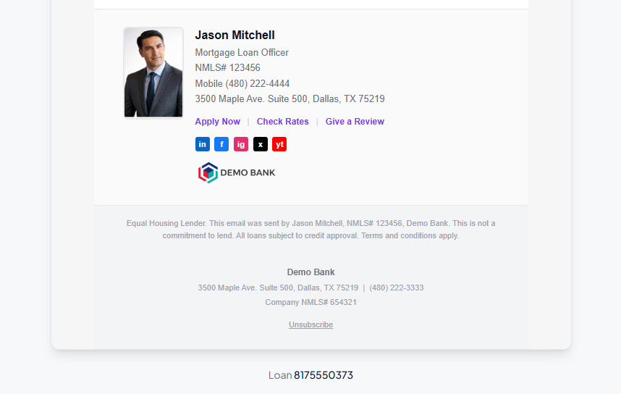
Review
Send Email

Slide 28
Create custom
Thank you
Email to agent

Slide 29
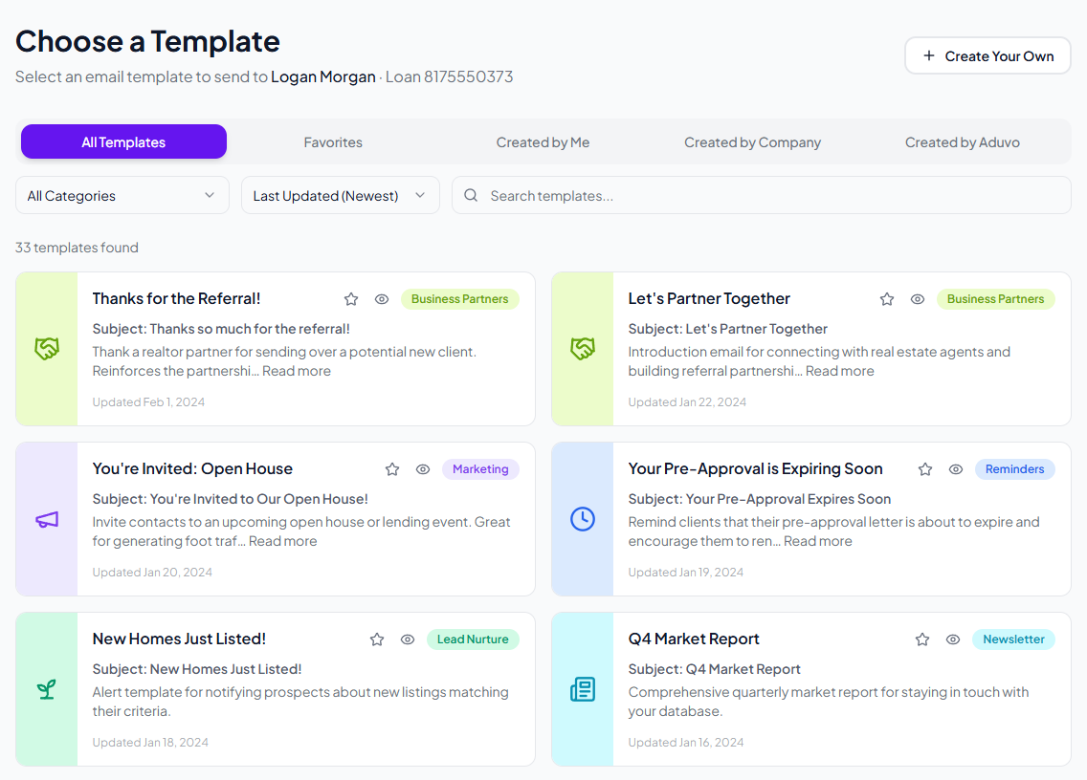
Notes:
Choose Create Your Own

Slide 30
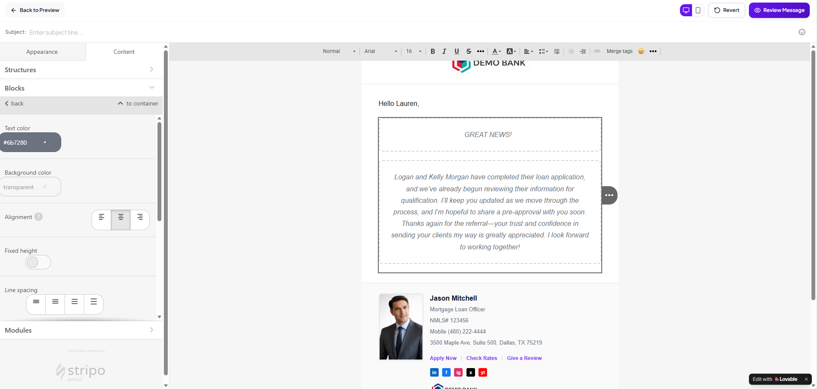



Create Your Own Message to Agent

Slide 31
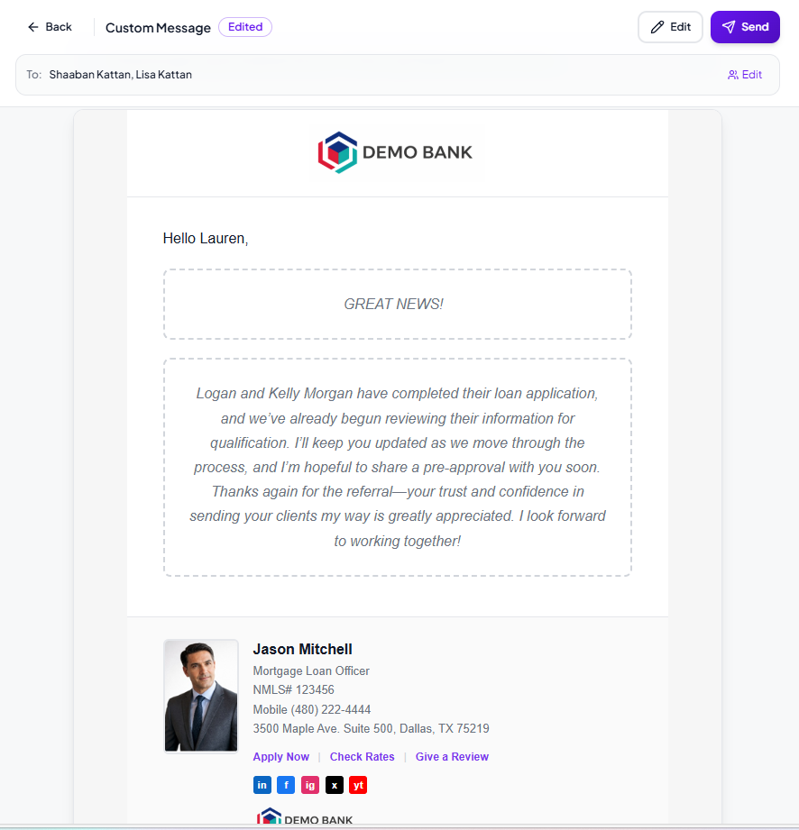
Review
Send Email

Slide 32
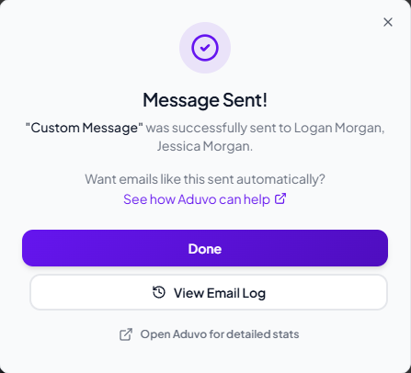


Slide 34
See What We’ve Done
  Sent email to client
  Sent Thank you Email to agent
What’s NExt

Slide 35
Send
Status Email

Slide 36
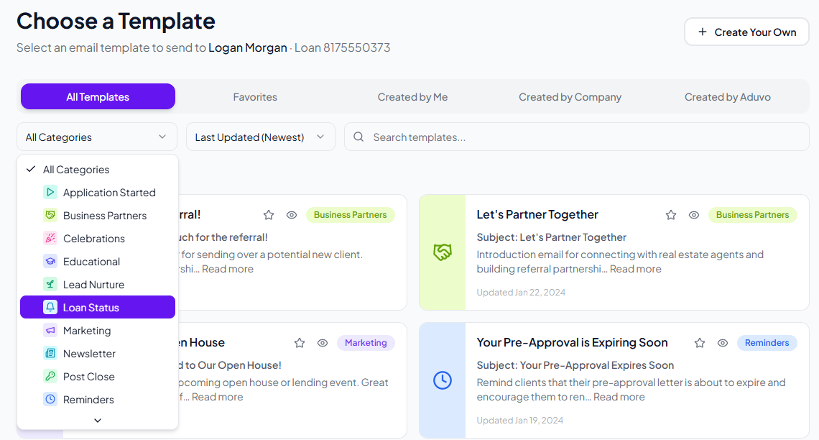

Slide 37
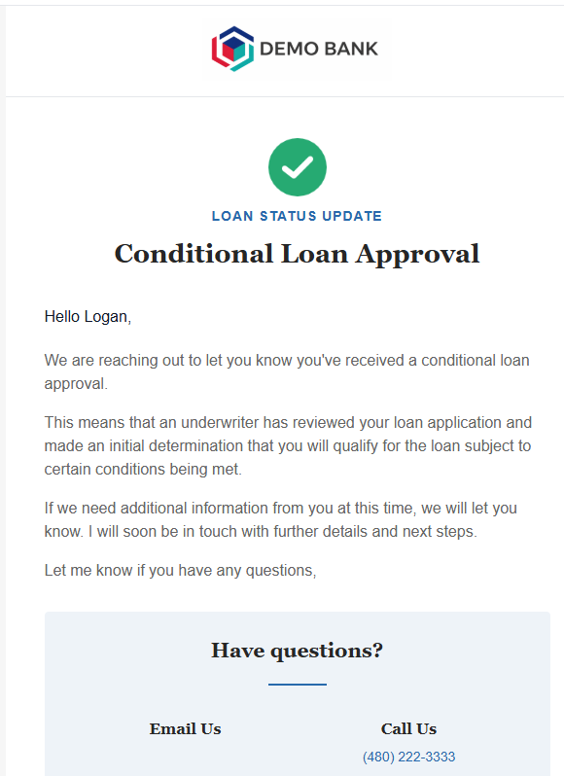
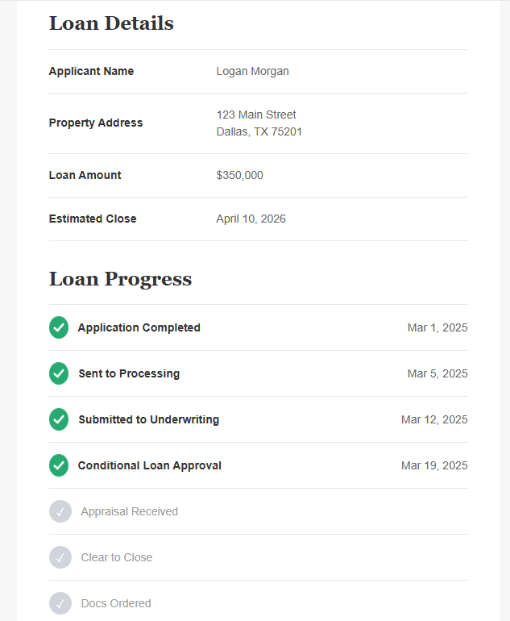
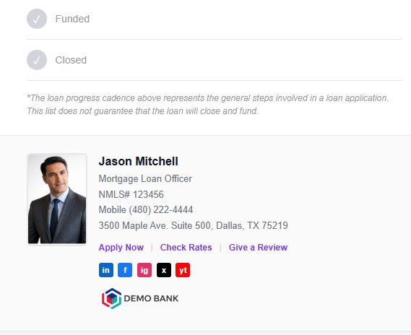

Slide 38

Loan Status Templates Available
1. Loan Application Completed
11. CLEAR TO CLOSE
2. Initial Disclosure Sent
12. Closing Docs Ordered
3. Initial Disclosure Received
13. Closing Docs Sent
4. Submitted to Processing
14. Closing Docs Received
5. Title Report Ordered
15. Closed
6. Title Report Received
16. FUNDED
7. Appraisal Ordered
17. Suspended
18. Denied
8. Appraisal Received
9. Submitted to Underwriting
19. Withdrawn
10. Conditionally Approved

Slide 39
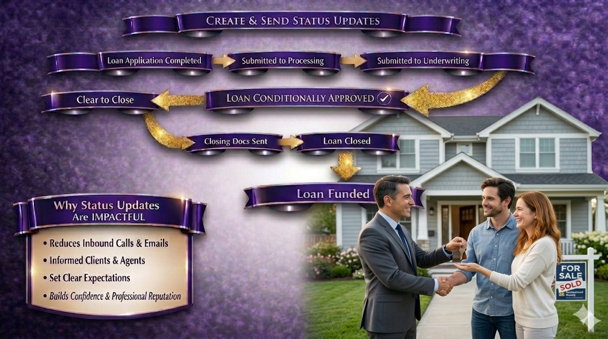

Slide 40
PATH_MARKETING

Slide 41
Automated Campaigns
Why SO Impactful?
Why SO Impactful?

Slide 42
Always On!
Always On!
Consistency = Credibility
Consistency = Credibility
Saves Time without Losing Personal Touch
Saves Time without Losing Personal Touch
Set it and Forget it
Set it and Forget it

Slide 43
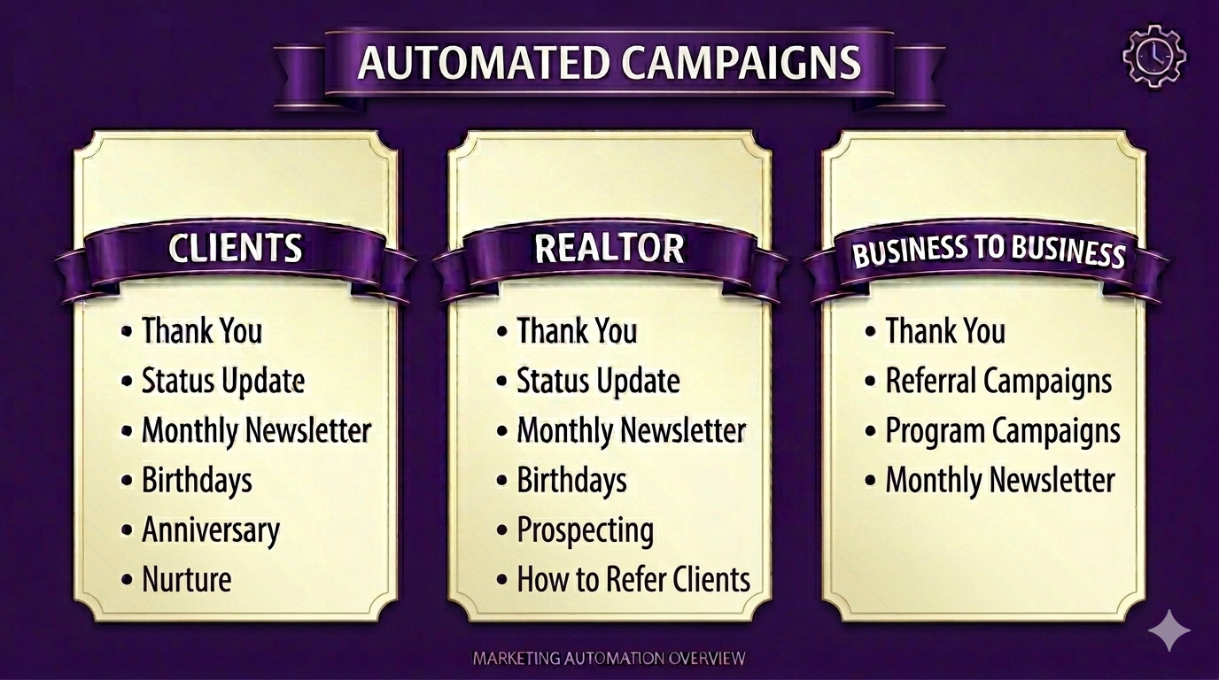

Slide 44
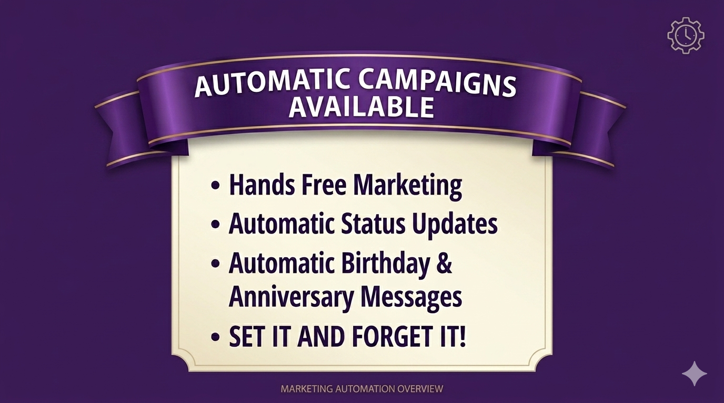

Slide 45
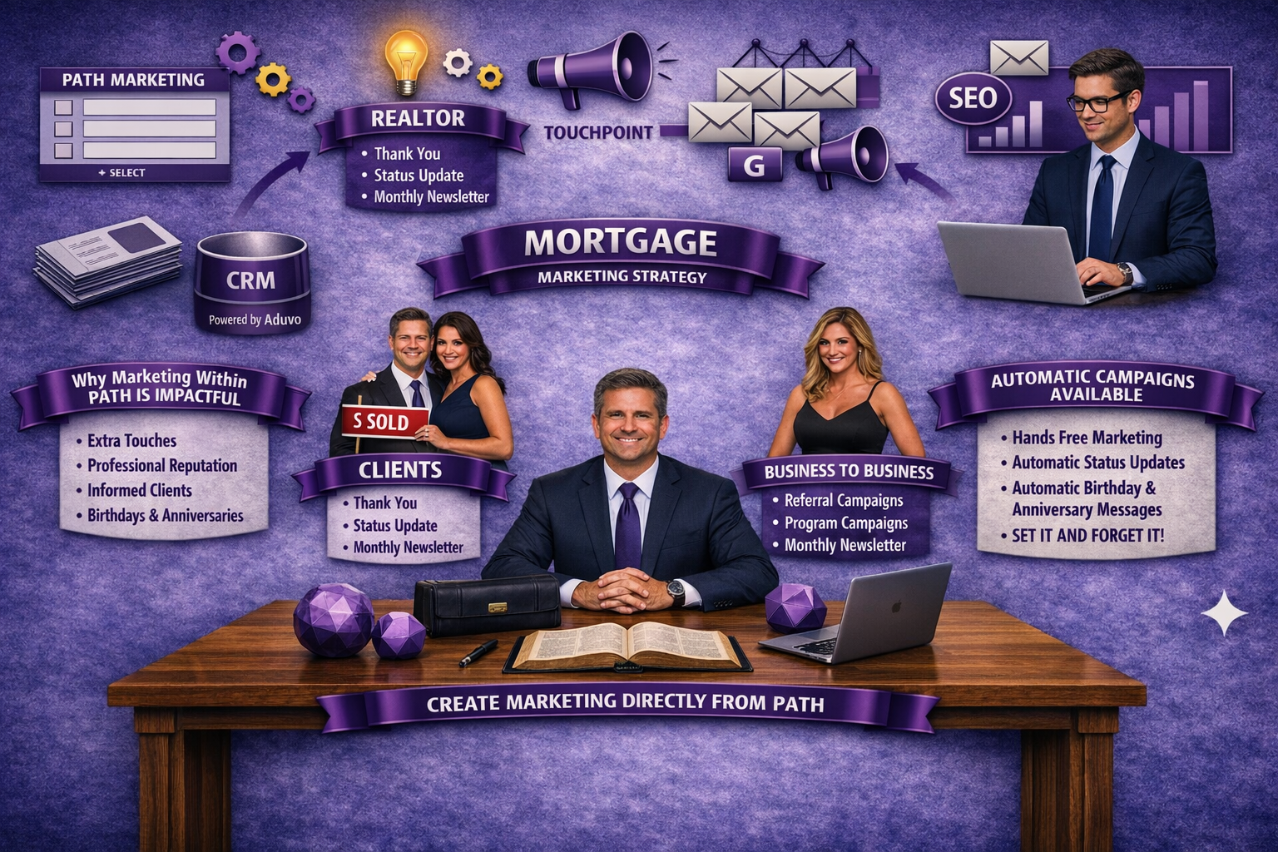

Slide 46
RECAP –
WHY MARKETING IS SO IMPORTANT
Keeps you top of mind in referral driven industry
Turns past clients into repeat and lifetime clients
Builds trust in a highly emotional, high-stakes transaction
Strengthens referral relationships with realtors and partners
Educates borrowers and reduces friction
Differentiates you in a crowded, competitive market
Improves retention in a rate-sensitive environment
Maximizes ROI from loans already closed
You receive a notification from PATH that their application is complete
Creates consistency across teams and branches

Slide 47

VISIT
Notes:
GO VISIT Aduvo in the Optimization Rm
Set up time to get you started
Onboarding SUPER EASY - 15 min

Slide 48

THANK YOU

