Slide 1

What’s new in calyx path
Lee tran

Slide 2
AGENDA
Upcoming Release Schedule
Request Process
Path Release Planning
New Features in 2026 R1
Future Roadmap

Slide 3

Upcoming Release Schedule
2026 R1 Release – April 19th, 2026
2026 SP3 Release – Target Date June 7th, 2026
2026 R2 Release – November/December 2026

Slide 4
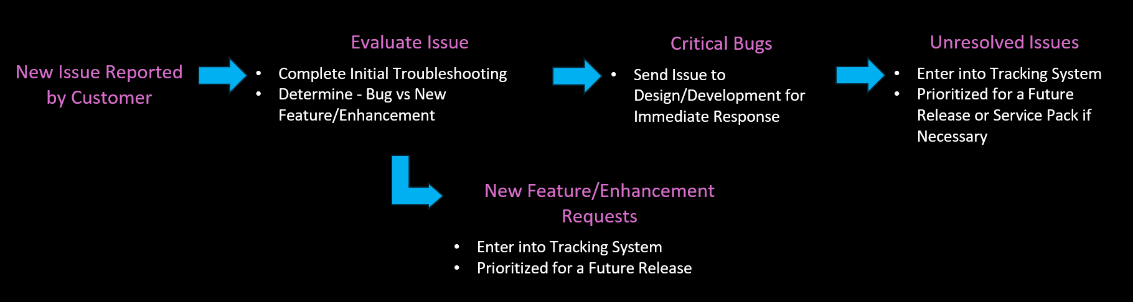
Request Process

Slide 5
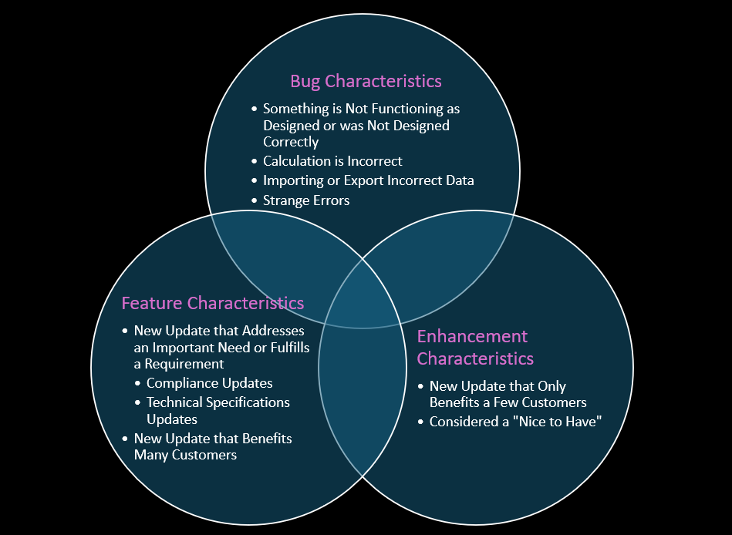
Request Classification

Slide 6
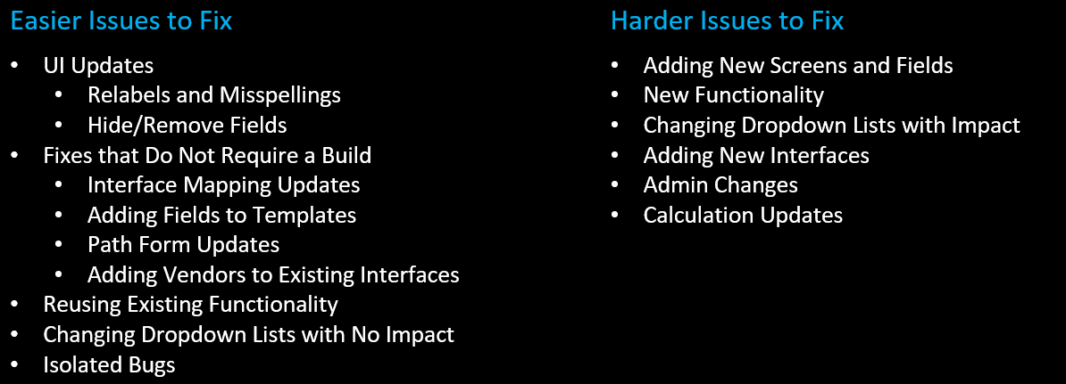
Development Scope

Slide 7
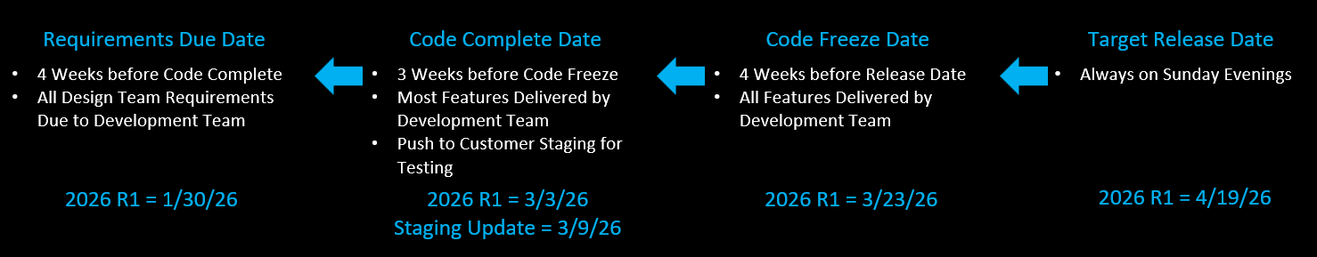
Release Cycles

Slide 8

What’s in the Upcoming Release
2026 R1 Release Overview

Slide 9
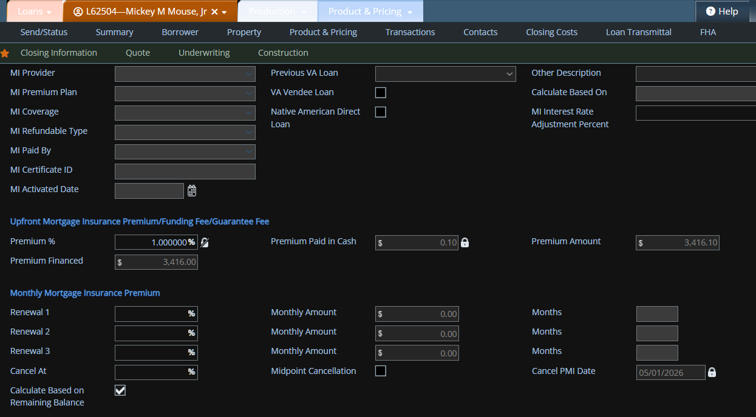
New Features - Loan
Mortgage Insurance Calculation Update

Slide 10
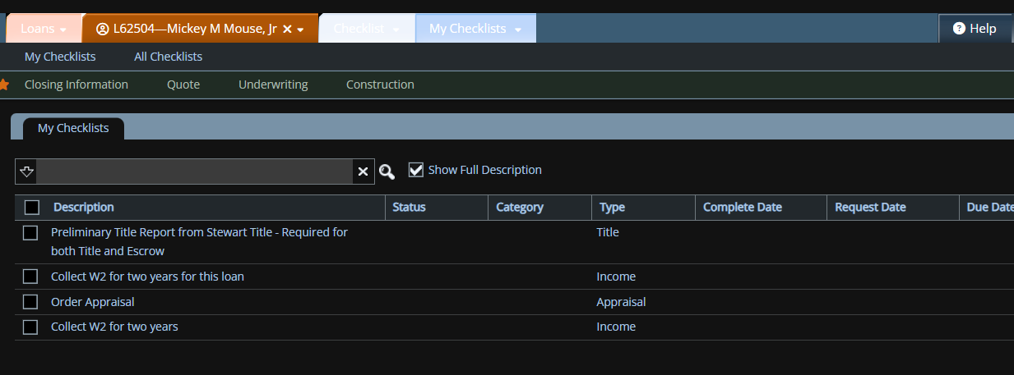
New Features - Loan
Checklist Enhancement

Slide 11
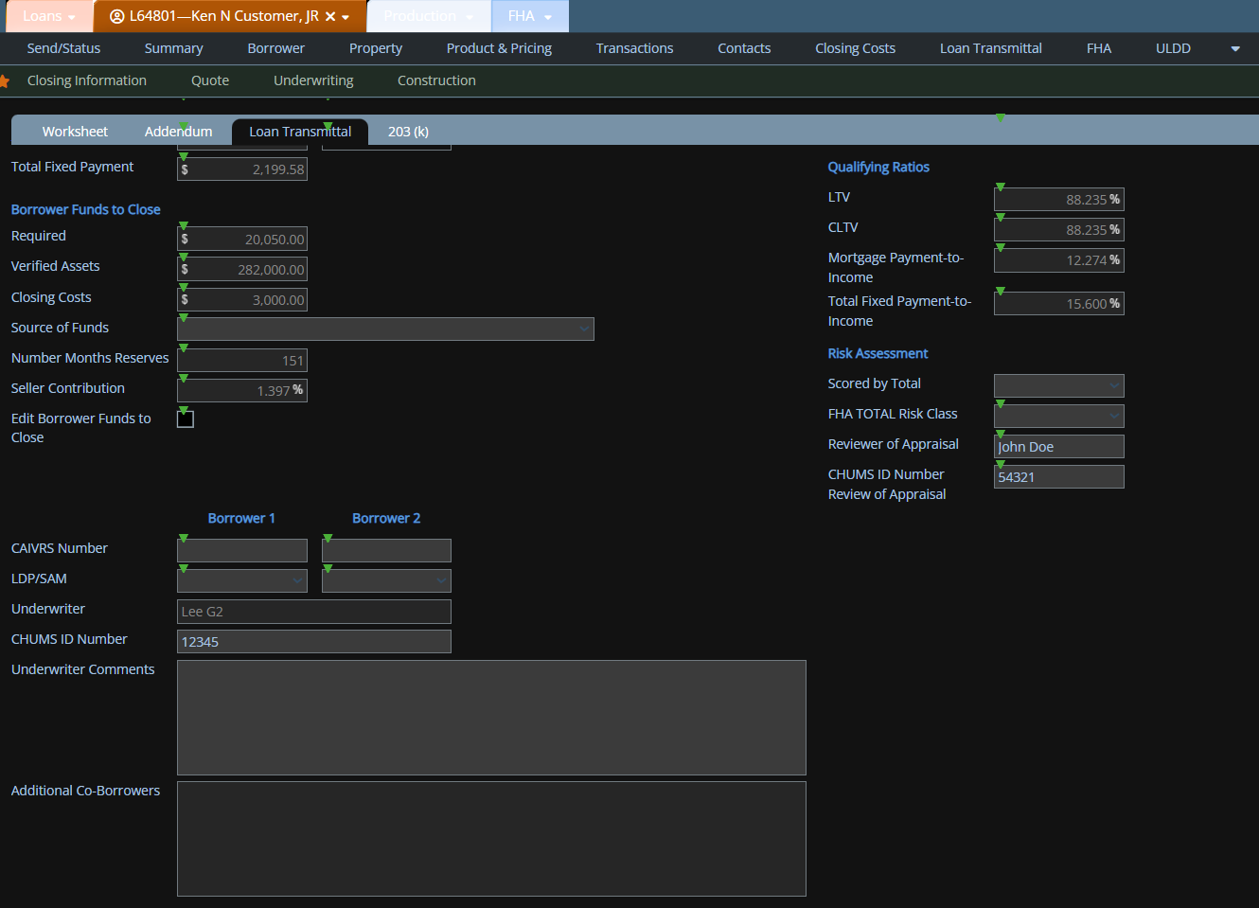
New Features - Loan
Separate Fields for Underwriter and Reviewer of Appraisal for FHA Loans – FHA Loan Transmittal and Appraisal Analysis Screens

Slide 12
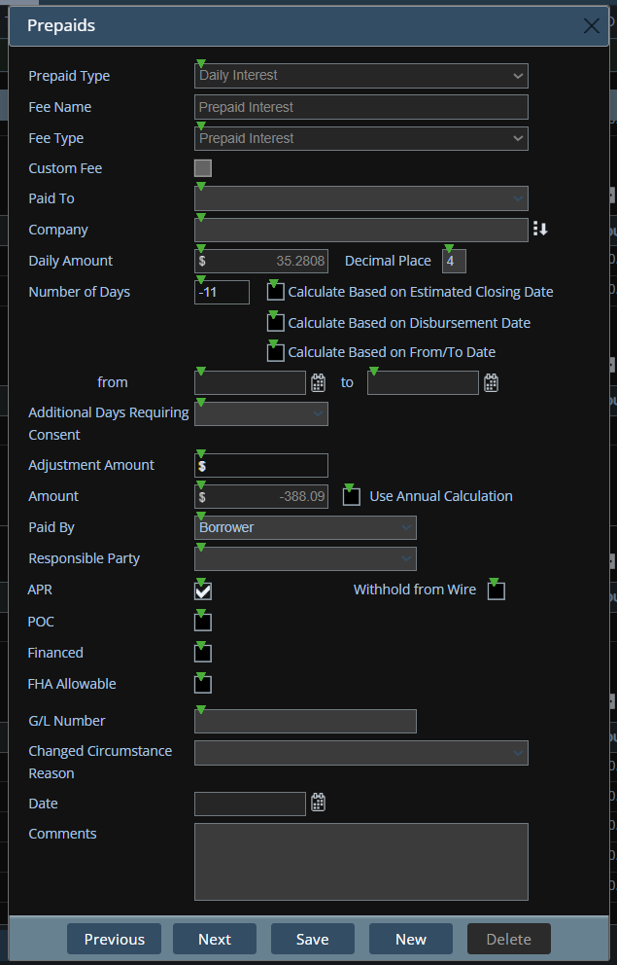
New Features - Loan
Negative Prepaid Interest Loans

Slide 13
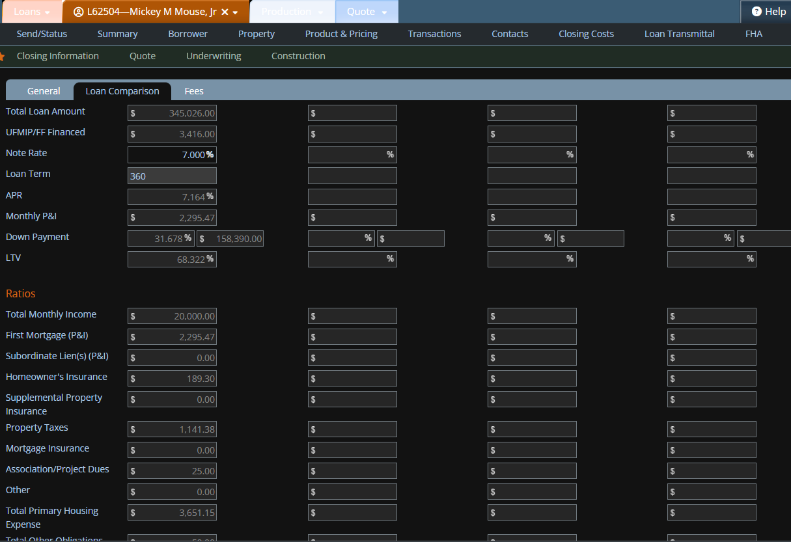
New Features - Loan
Quote Screen - Loan Comparison Improvements

Slide 14
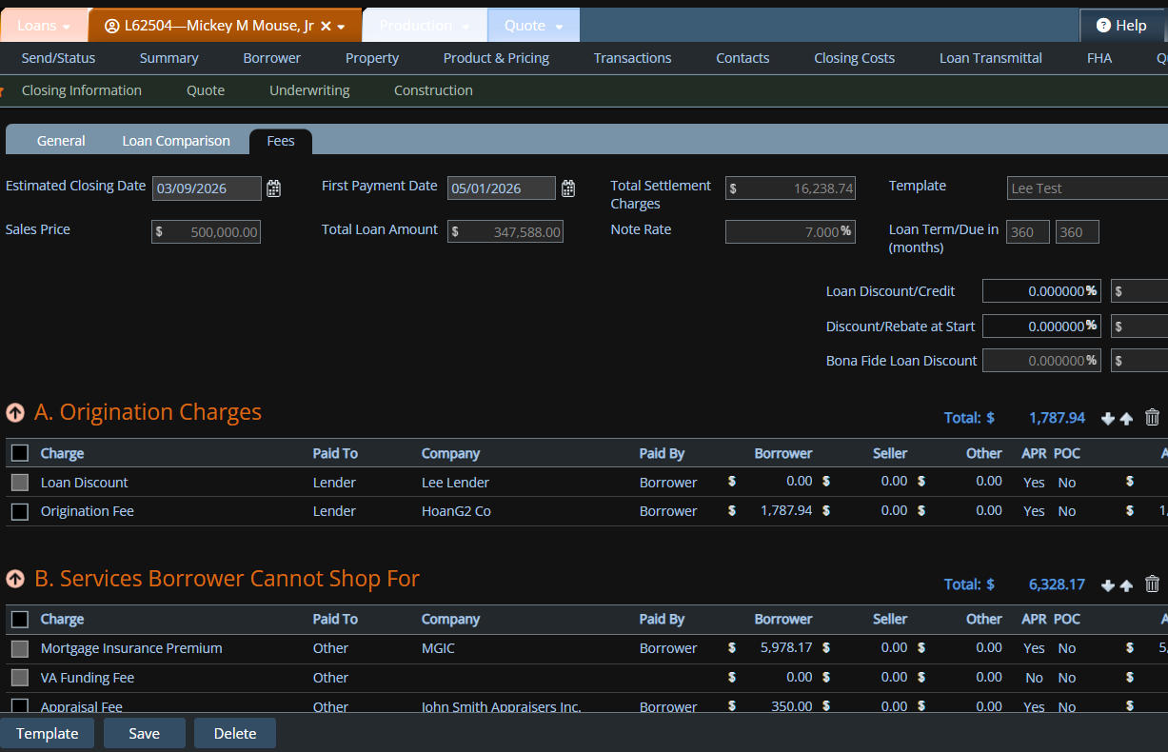
New Features - Loan
Quote Screen – Added Fees Tab

Slide 15
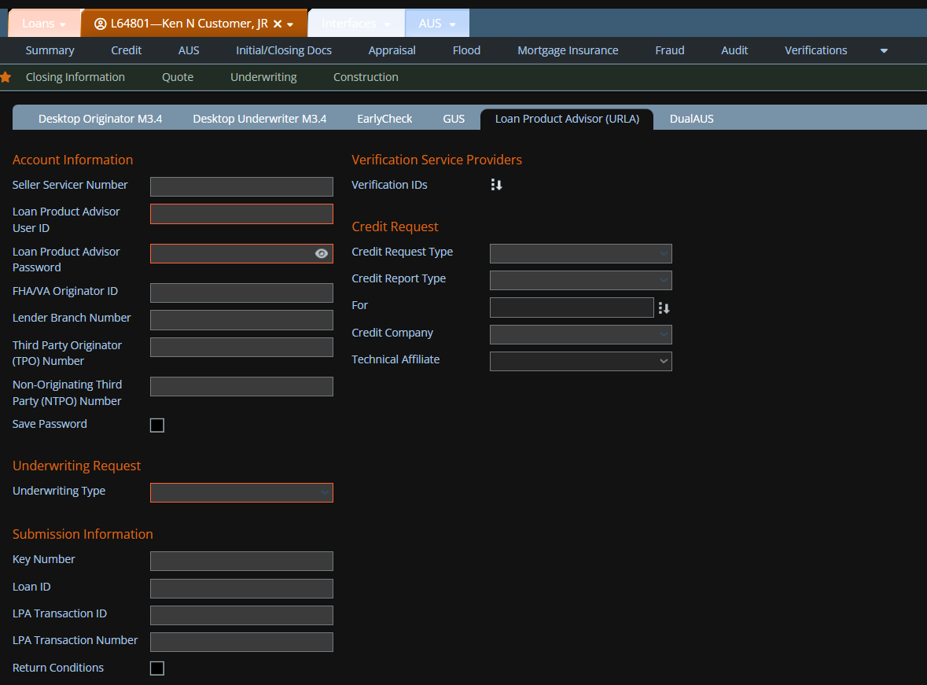
New Features - Interfaces
LPA – Return Conditions

Slide 16
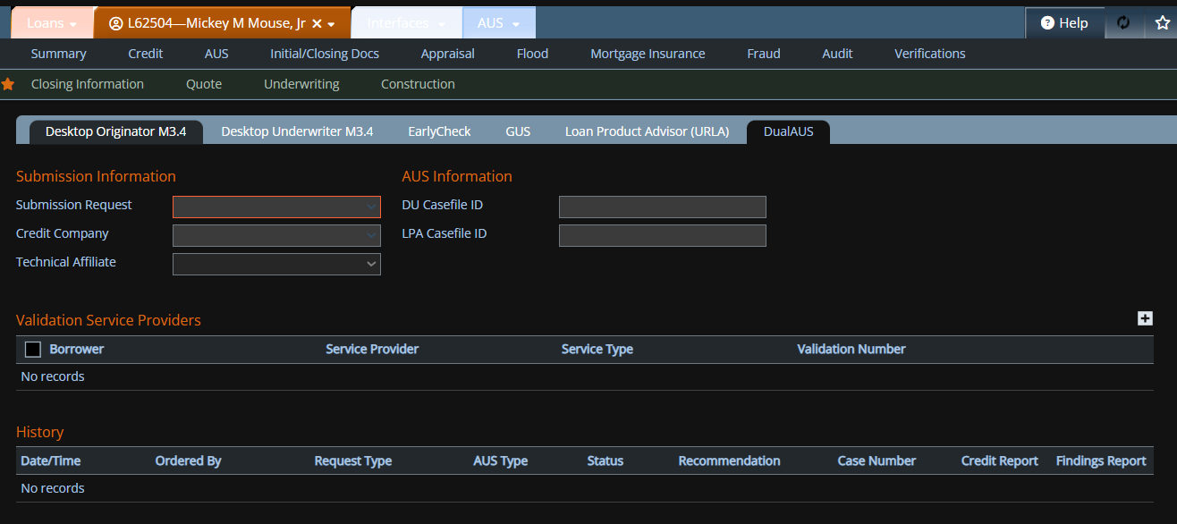
New Features - Interfaces
Dual AUS Enhancement

Slide 17
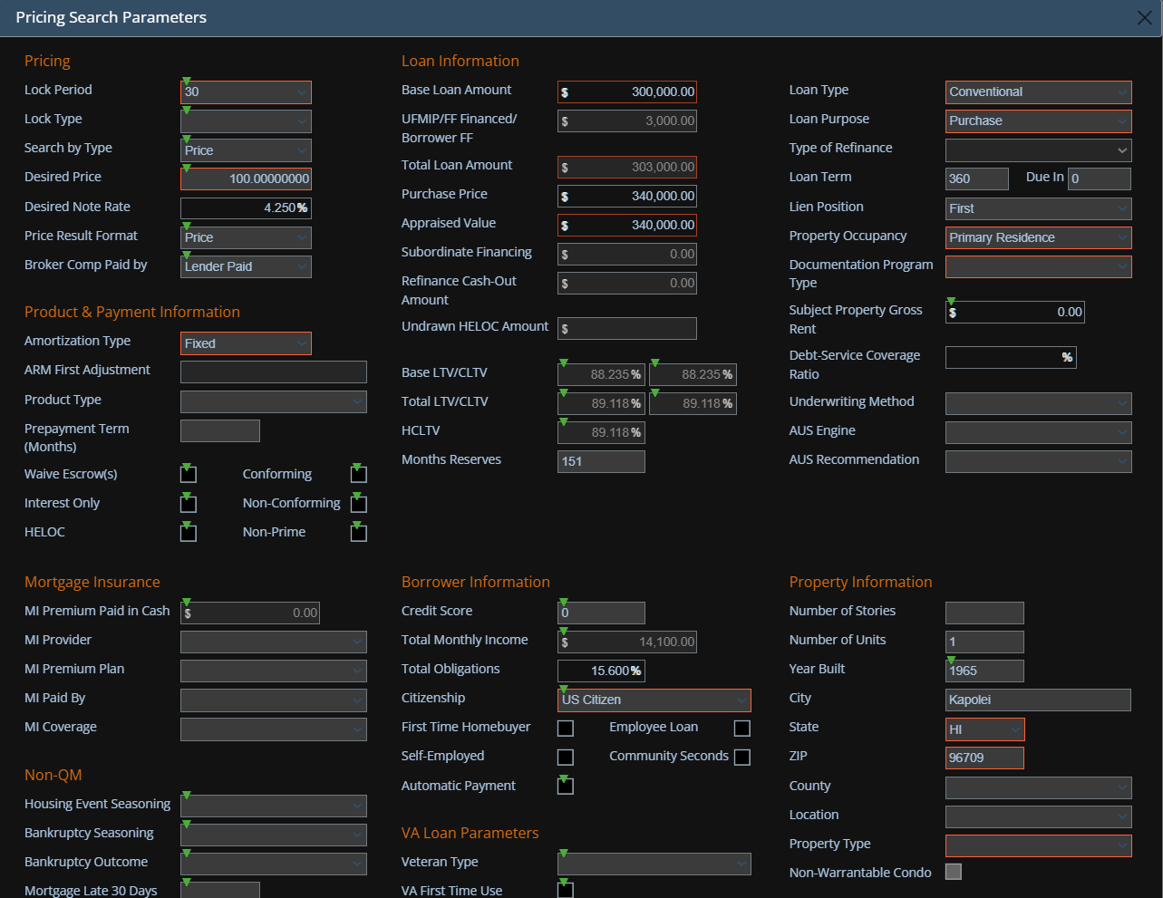
New Features - Interfaces
Pricing – Edit DTI

Slide 18
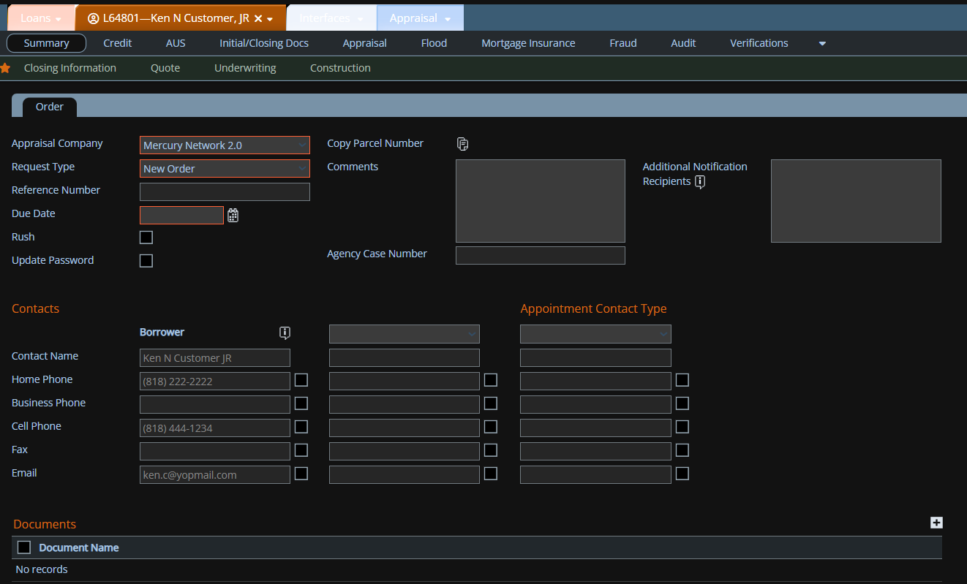
New Features - Interfaces
Mercury Network Appraisal Interface Update to Support UAD 3.6

Slide 19
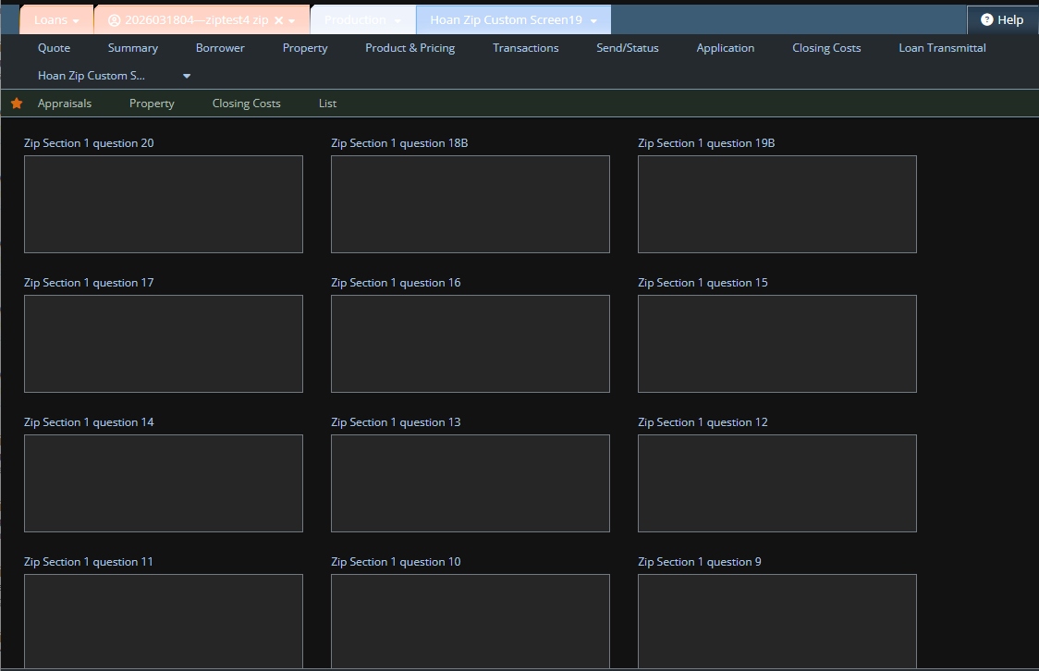
New Features - Interfaces
Zip Custom Data Import

Slide 20
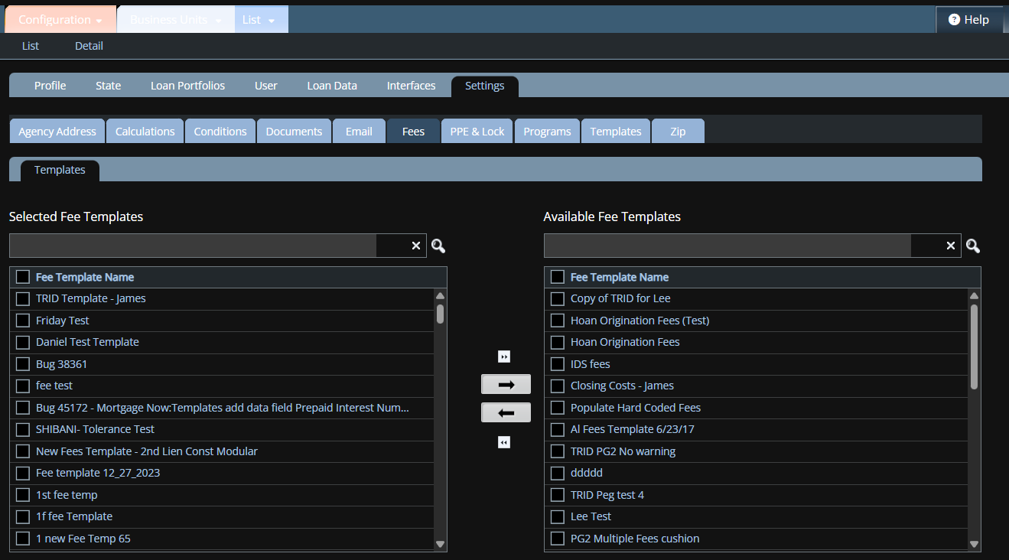
New Features - Admin
Business Unit Settings Enhancement

Slide 21
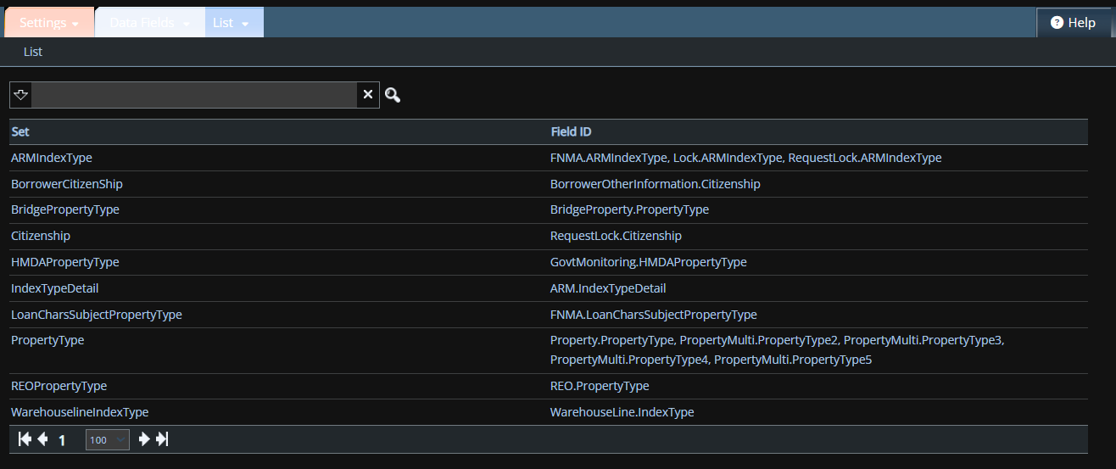
New Features - Admin
Data Field Settings

Slide 22
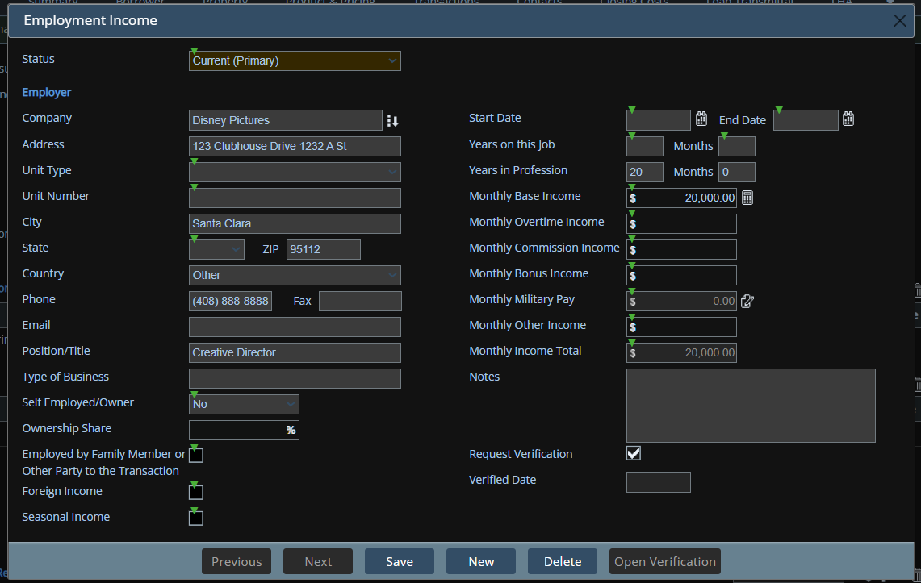
New Features - Admin
Screen Access Update

Slide 23
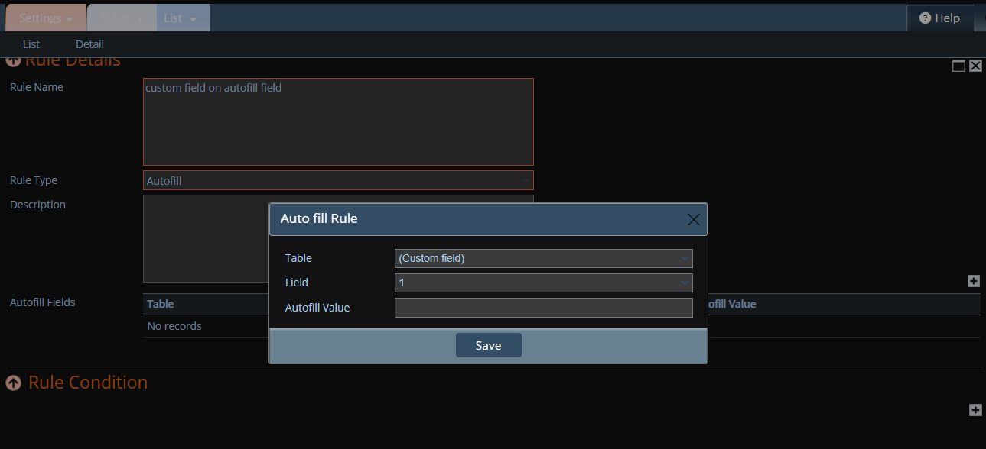
New Features - Admin
Custom Fields Enabled for Autofill Rules

Slide 24
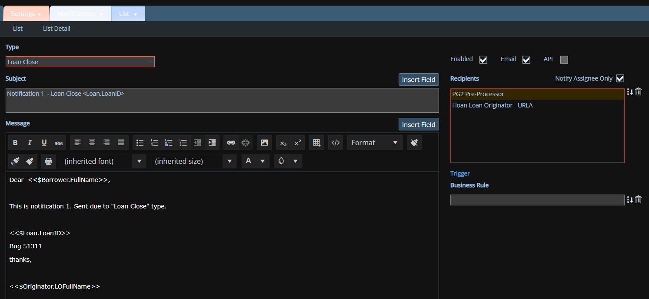
New Features - Admin
Notifications – New Type “Loan Close”

Slide 25
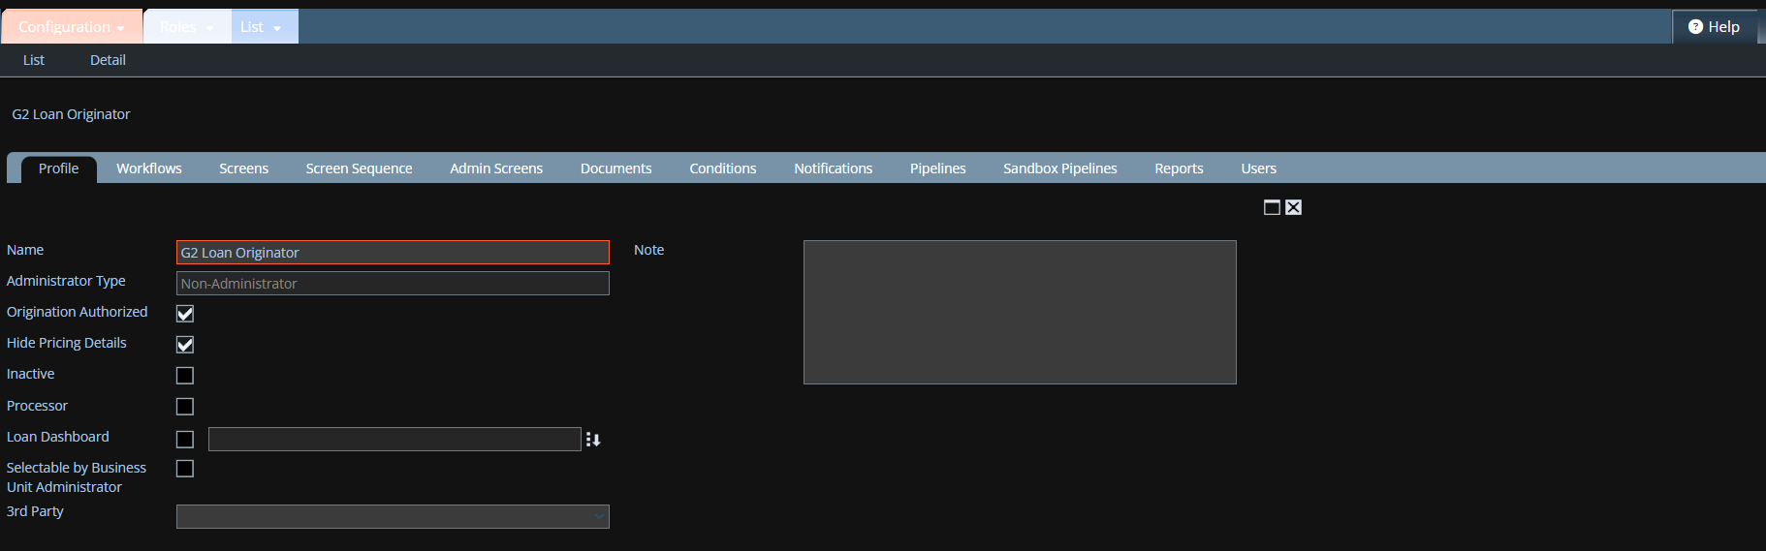
New Features - Admin
Role Configuration – Hide Pricing Details

Slide 26
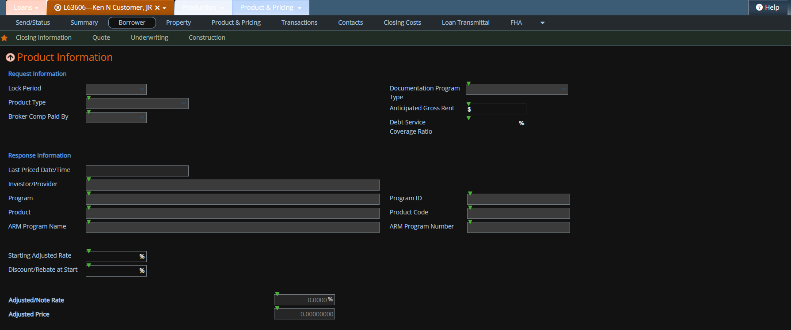
New Features - Admin
Role Configuration – Hide Pricing Details – Quote, Product & Pricing, and Lock Request Screens

Slide 27
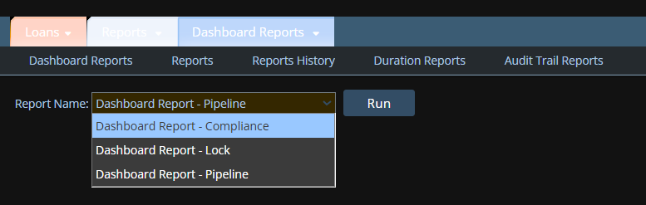
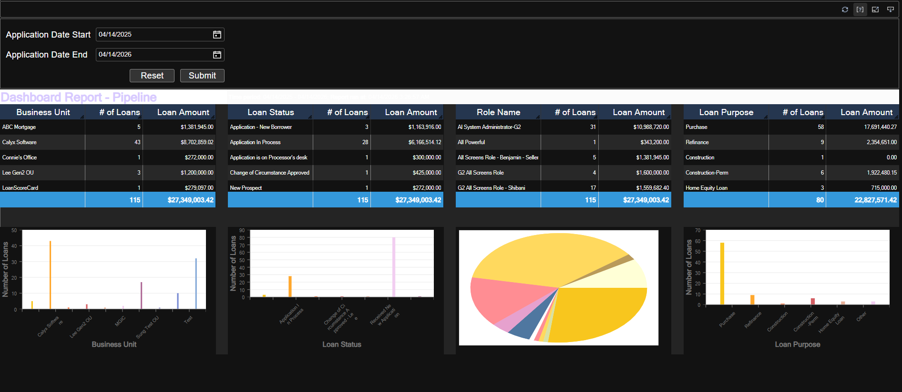
New Features - Reports
Dashboard Reports – Pipeline, Lock and Compliance Reports

Slide 28
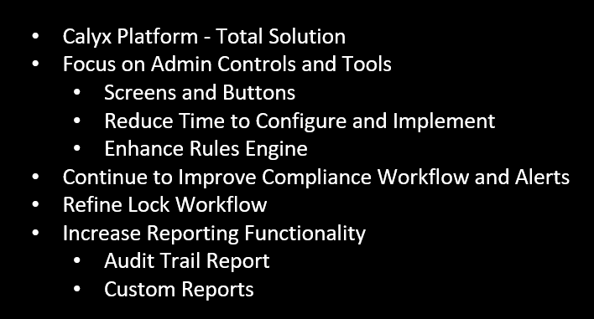
Future Roadmap

Slide 29

Final Q&A
THANK YOU for Attending bloom!
Lee Tran
866-302-2599
lee_tran@calyxsoftware.com
www.pathsoftware.com

