Slide 1

Rules & Validation 2: Applying Rules in Real Workflows: From Intake to Approval

Slide 2
“If we can enable them to do their jobs more efficiently with automation, they can handle more loans with better quality.”
Sudamys Alfonso
Senior Director, Seller Strategy & Optimization
Freddie Mac

Slide 3
Streamline
Efficiency
Automation

Slide 4
Automation
Fees Engine
Conditions Engine
Analyzer Engine

Slide 5
Fees Engine
Instead of navigating title and escrow websites for estimates, you can populate closing costs with the push of a button.

Slide 6
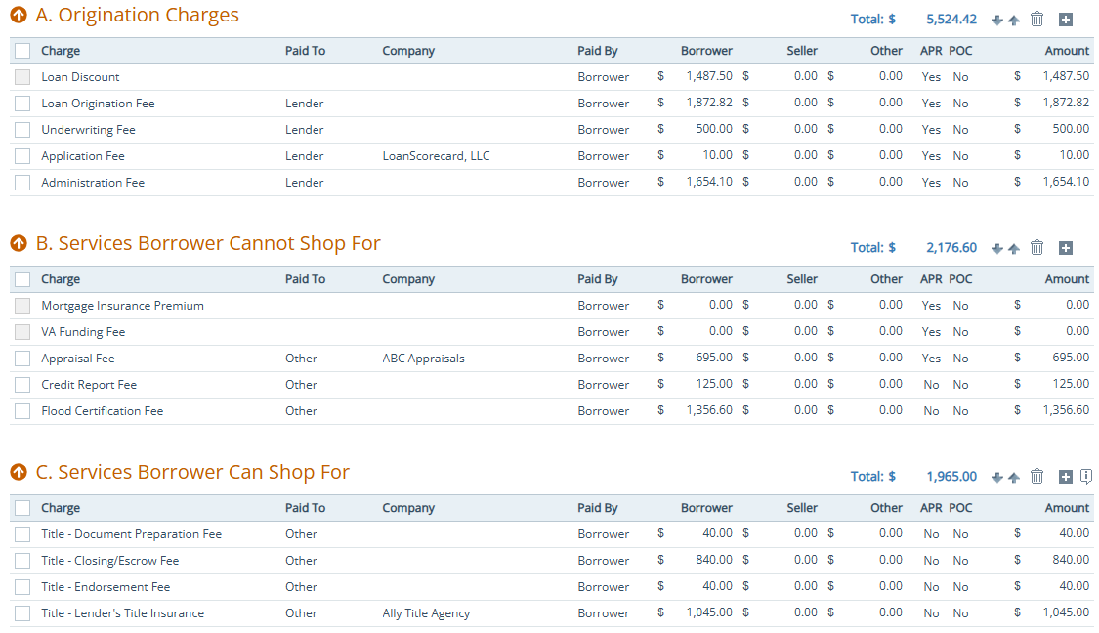
Fees Engine
The fees engine helps ensure closing costs are both complete and accurate.
It can automatically add fees that may be missing.
Update fees that were underestimated.

Slide 7
Fees Engine
The fees engine can calculate specific fees such as Lender’s Title Policy when the title company provides the required calculations.
It can also calculate state and local fees, including transfer taxes, if the appropriate formulas for each jurisdiction are provided.

Slide 8
Conditions Engine
The conditions engine can auto generate both generic and smart conditions with the push of a button.

Slide 9
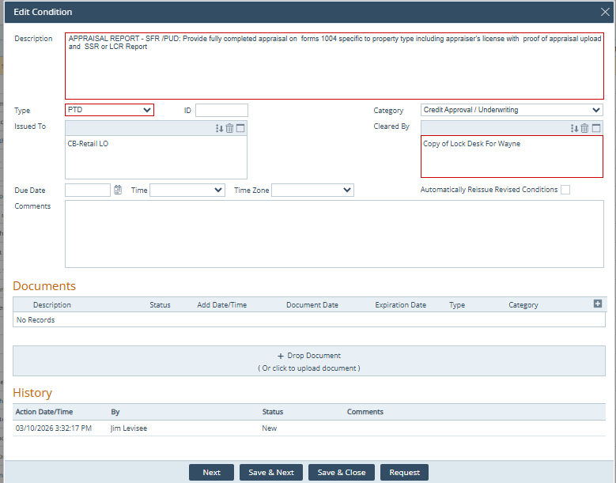
Conditions Engine
The conditions engine can automate underwriting conditions across every loan program:
FHA
VA
Conventional
USDA
Non-QM
HELOC

Slide 10
Conditions Engine
Condition Types:
(Prior to Documents (PTD), Prior to Funding (PTF), Submission, or Suspension)
Condition Category:
(Appraisal, Assets, Credit, Income, Closing, or Property)
*Who is authorized to clear each condition within the workflow.

Slide 11
Analyzer Engine
The analyzer engine can compare loan data to guidelines at the click of a button.

Slide 12
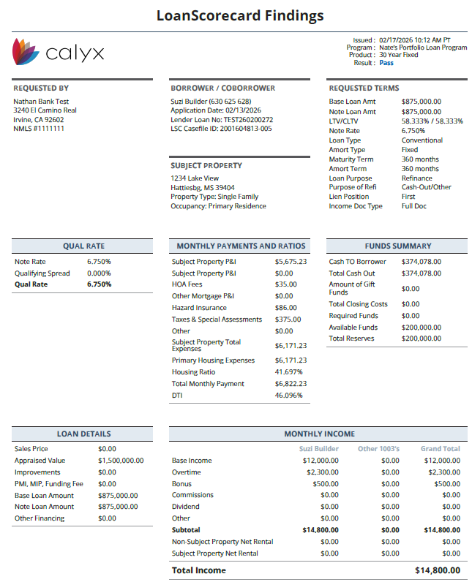
Analyzer Engine
The analyzer engine evaluates data contained in the 1003 loan application (Mismo 3.4 XML) as well as the credit report (credit XML).
Reviewing borrower information such as income, assets, credit events (bankruptcy, foreclosure, short sale, mortgage lates, etc.).

Slide 13
Analyzer Engine
In addition to the standard fields within the loan application and credit report, the analyzer engine can also evaluate data that is considered out of band (information that is not on the 1003 application).
Rules can be written to mine for data that is in the 1003 application, credit report or out of band.

Slide 14

How can we help grow your business?
Analyzer
Analyze Loan Data
Fees Engine
Streamline Closing Costs
Reduce Defects
Conditions
Engine
Streamline Conditions
Custom Tailored

Slide 15
Kevin Kauffman
SVP and Head of Single-Family Seller Engagement
Freddie Mac
The common thread of best-in-class lenders for reducing loan origination costs is leveraging digital capabilities.

Slide 16

THANK YOU
Nathaniel Peters
949-377-0940
nathan.peters@loanscorecard.com
www.pathsoftware.com

