Slide 1
Path
Secondary Process
Calyx Bloom 2026 Connie Guerin / Lee Tran

Slide 2
Housekeeping
Legal Disclaimer
The information presented herein is confidential and proprietary to Calyx Technology Inc., doing business as Calyx Software (“Calyx”), and may not be disclosed without the prior written consent of Calyx. This presentation is intended solely to provide general information and does not constitute legal, financial, or other professional advice or opinion. The content is believed to be accurate as of the date of presentation; however, Calyx makes no representations or warranties regarding its completeness or accuracy. Any examples included are for illustrative purposes only. Any resemblance to actual persons, entities, places, or events is purely coincidental and unintentional. Such examples are not intended to serve as legal advice or guidance. No part of this presentation may be reproduced, modified, distributed, printed, or publicly displayed without the prior written permission of Calyx.
© Calyx Technology, Inc. 2026. Calyx and Calyx Software are registered trademarks of Calyx Technology, Inc. All rights reserved.

Slide 3
Following the Money in Path
There are 4 Secondary Screens within the Path System:
Pricing Review
Purchase Advice
Final Commitment
Profit & Loss

Slide 4
AGENDA
Today we will cover the following:
Lock Confirmation Screen
Secondary Screen Design
Screen Sections
Profit and Loss Screen

Slide 5
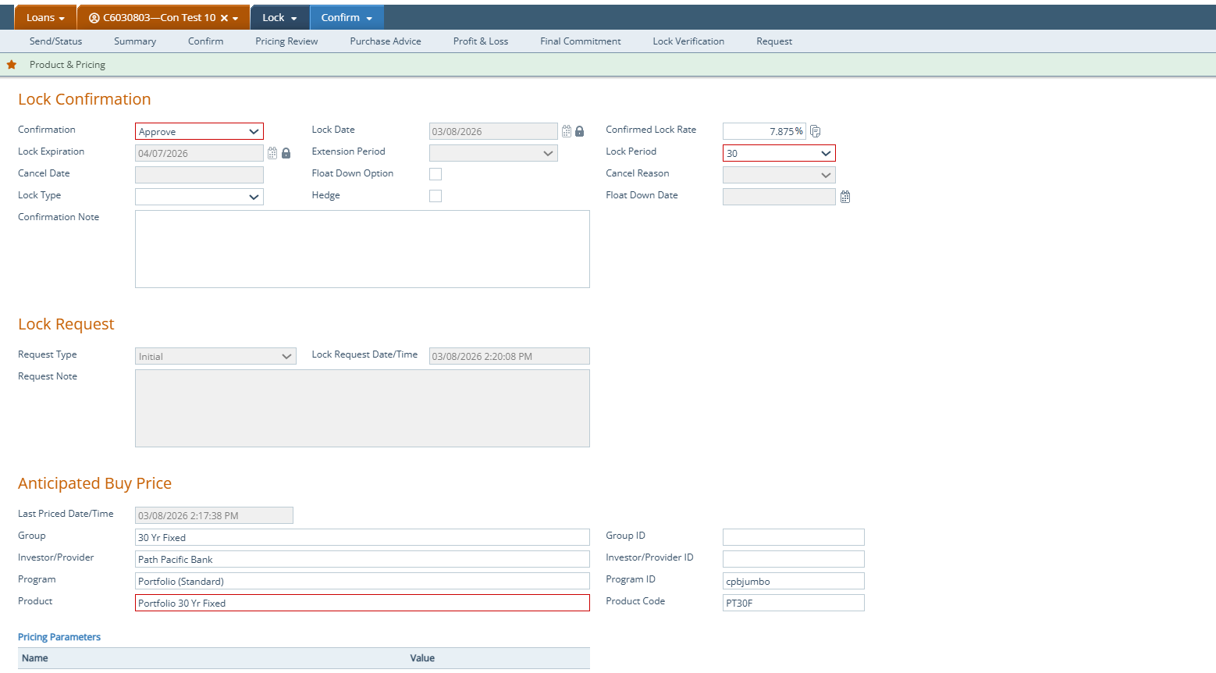
LOCK CONFIRM SCREEN
The Lock Confirmation screen provides a summary of the lock request. Users can accept or reject a lock request, reprice, if necessary and capture Benchmark and/or Anticipated Sell pricing data.
The Lock Confirmation screen will help prepare for the Secondary process.

Slide 6
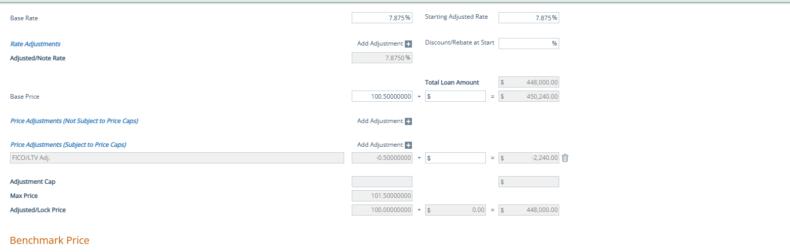
LOCK CONFIRM SCREEN
Note: Users who use any of the 3 pricing engines available in the Path Platform, will see the data automatically populate the Base rate, Adjusted Note Rate, Base Price & any Adjustments. Using an internal loan program will require the user to enter the data manually or have it templated.

Slide 7
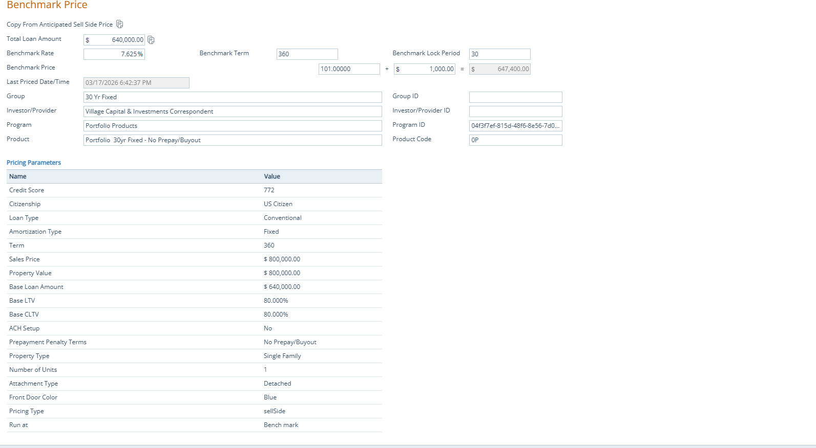
LOCK CONFIRM SCREEN

Slide 8
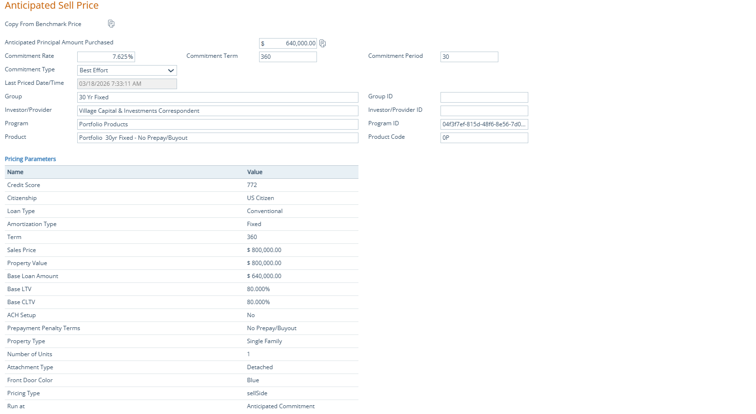
LOCK CONFIRM SCREEN

Slide 9
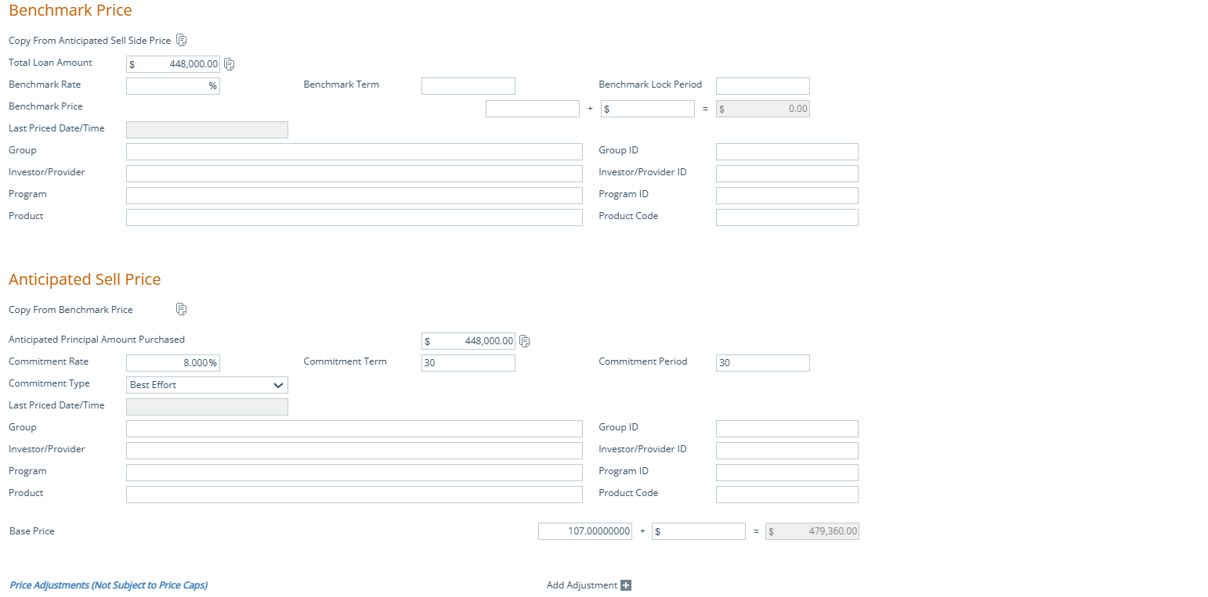
LOCK CONFIRM SCREEN

Slide 10
PRICING REVIEW
The Pricing Review screens provide a breakdown of the Price throughout the loan's life cycle.
For simplicity, the Benchmark, Realized Anticipated Sell and the Investor Name will flow automatically to the Lock Screens.
From the Lock to Purchase Advice this screen shows a summary of the lock details.

Slide 11
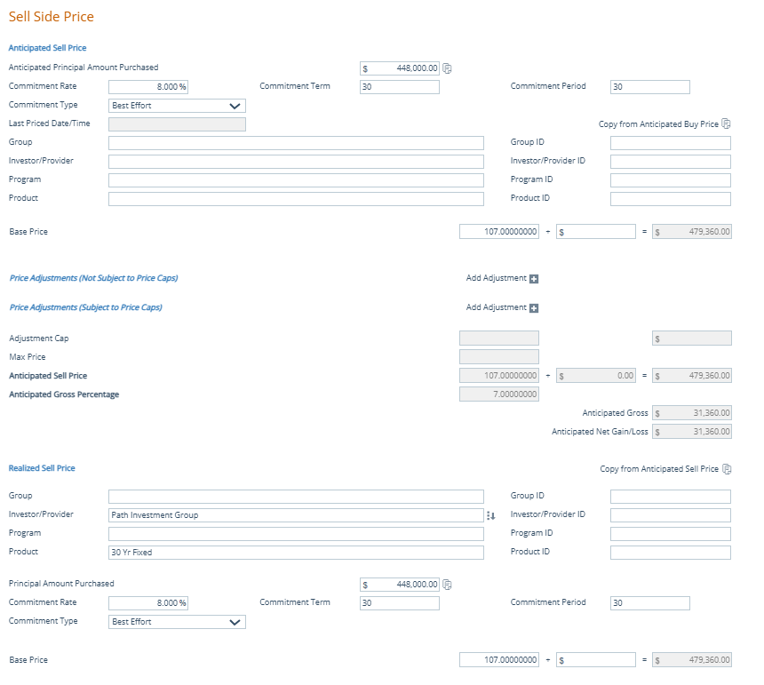
PRICING REVIEW SCREEN
Note: The Principal Amount Purchased needs to be manually entered or copied into the box for the Final Purchase Amount to be calculated correctly.

Slide 12
PURCHASE ADVICE
The Purchase Advice screen provides the ability to record the Purchase Advice information that is contained in the Investors Purchase Advice statement.
The Investor Name and contact information as well as the Realized Sell Price data will flow to the Pricing Review, Profit & Loss and Final Commitment screens automatically.

Slide 13
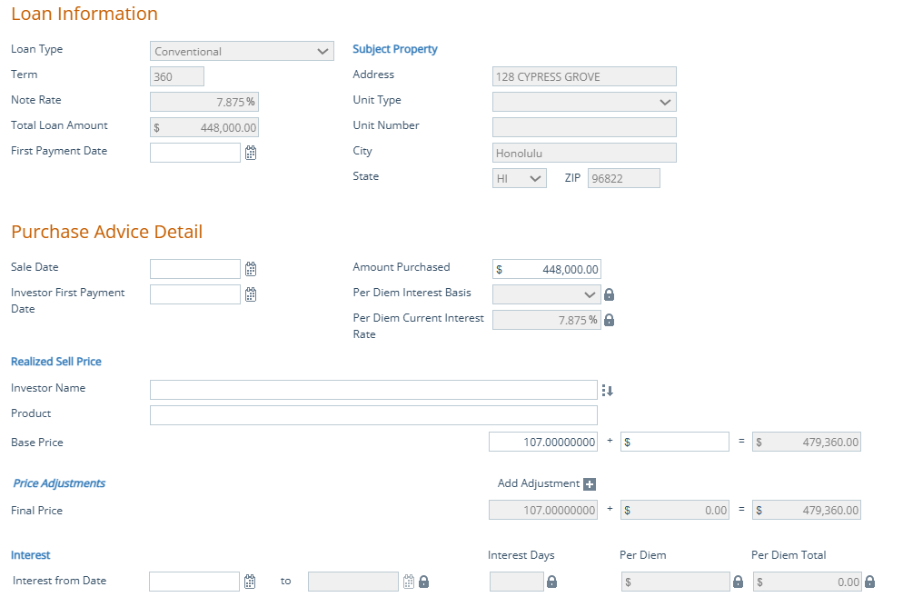
PURCHASE ADVICE
Note: It’s important to enter your dates (First Payment Date, Sale Date, and Investor First Payment Date, etc.) since many of the fields have logic that will trigger other functions.

Slide 14
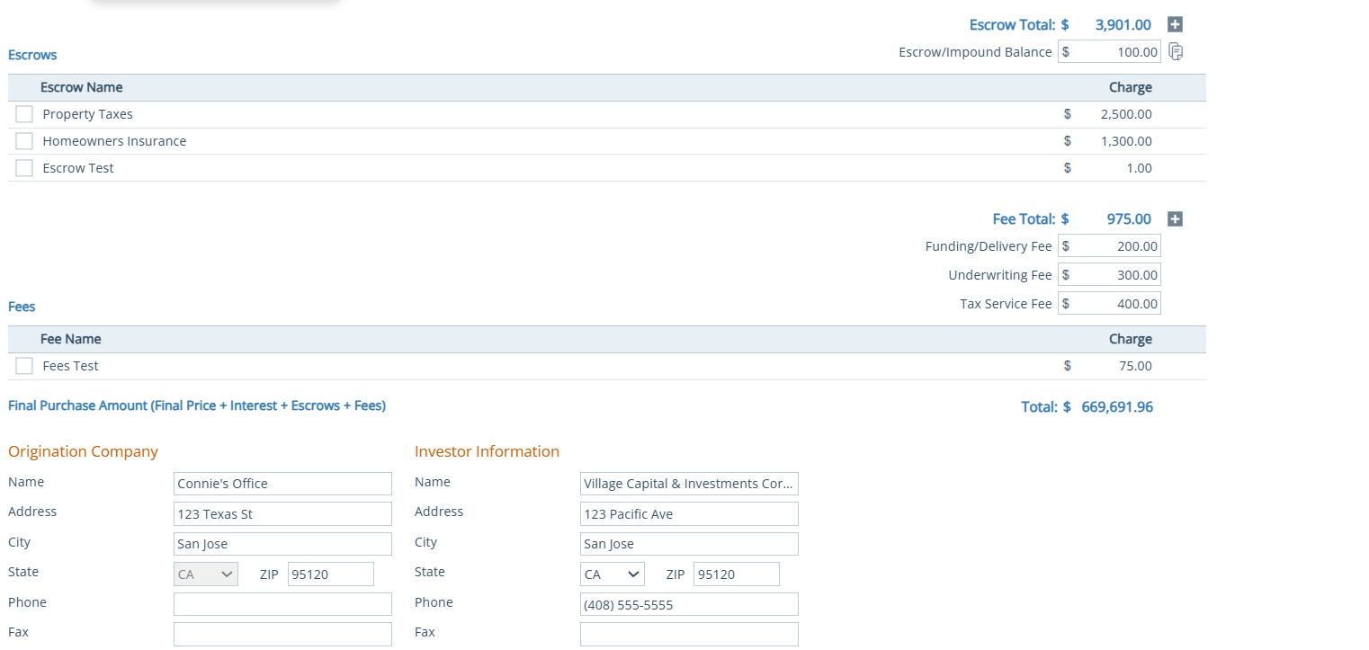
Purchase Advice Screen
Note: Escrow fees from Section G of the fees sheet, need to be manually entered by using the plus icon.

Slide 15
FINAL COMMITMENT
The Final Commitment screen provides a centralized place
where all necessary commitment and some optional datapoints can be recorded.
This screen captures Purchase Price all the way through Investor Delivery Information.

Slide 16
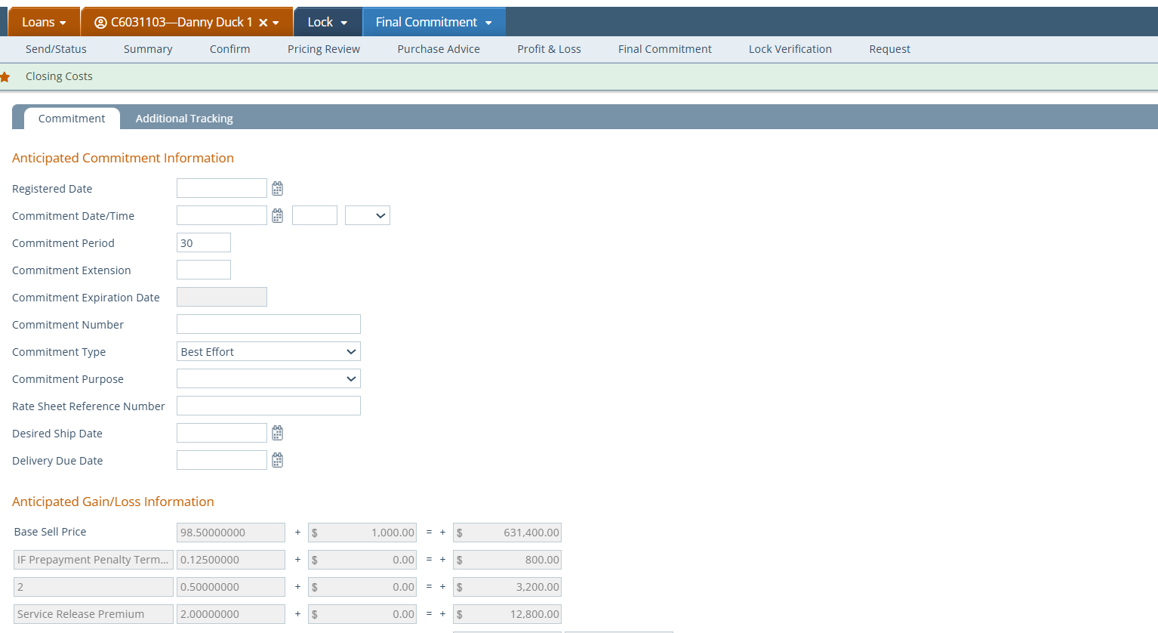
Final Commitment Screen
Note: The Anticipated Commitment Information section is optional for the user to complete.
Note: If the previous Lock and Secondary screens have been entered, the data from those screens will appear in the Anticipated Gain/Loss Information section.
If you don’t see data populated in this section, please review your Confirm, Pricing Review & Purchase Advice screens.

Slide 17
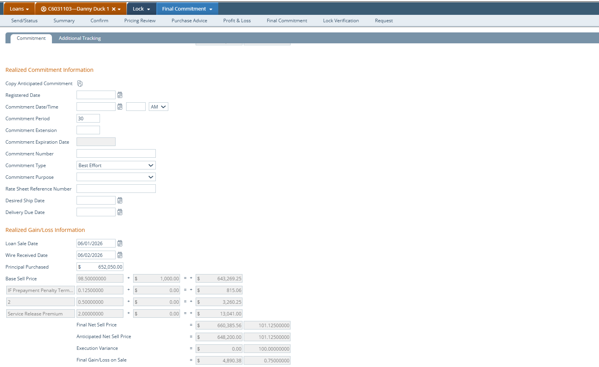
Final Commitment Screen
Note: It is important to enter dates if it applies to your transaction, before moving to the next section. The logic in Path depends on numerous fields like these.
Note: The Realized Gain/Loss Information section will show if you are achieving your margins. This data will flow from your other completed Secondary screens.

Slide 18
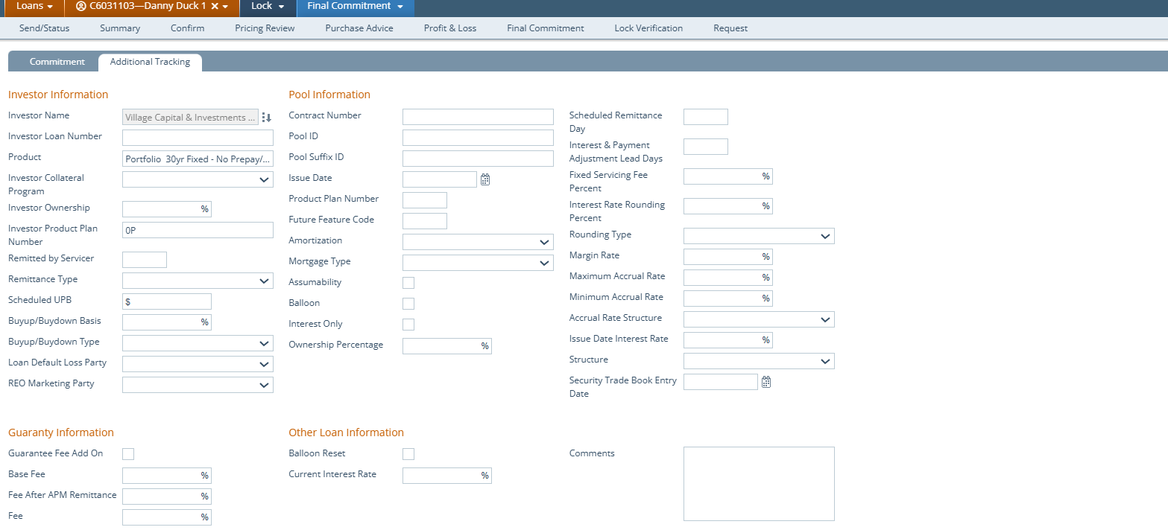
Final Commitment Screen
Note: The Additional Tracking tab is for users who need to pull loans they will sell on the Secondary Market. It will assist with the system of record & file documentation.

Slide 19
PROFIT & LOSS SCREEN
The Profit & Loss screen is a comprehensive view of how much the loan will earn or cost a lender.
It is designed to clearly build reports from the debits and credits throughout the life cycle of the loan.

Slide 20
Effectiveness of the Profit & Loss
How does Path’s Profit & Loss help Decision Makers / Business Owners?
Shows the most important aspects of the loan for
Decision Makers / Business Owners on one screen.

Slide 21
Profit & Loss screen flow
Lenders Debits and Credits
Gross Buy Side Total = (Realized Buy Price + Lender Debits & Credits + Commissions)
Net Buy Side Total = (Gross Buy Side Total – Total Loan Amount)
Warehouse Total (Warehouse Interest Amount + Additional Charges Total)
Additional Charges Total
Investor Debits and Credits
Commissions
Gross Sellside Total (Realied Sell Price + Investor Debits & Credits Total)
Net Profit/Loss on Sale (Gross Sellside Total – Warehouse Total – Gross Buyside Total)

Slide 22
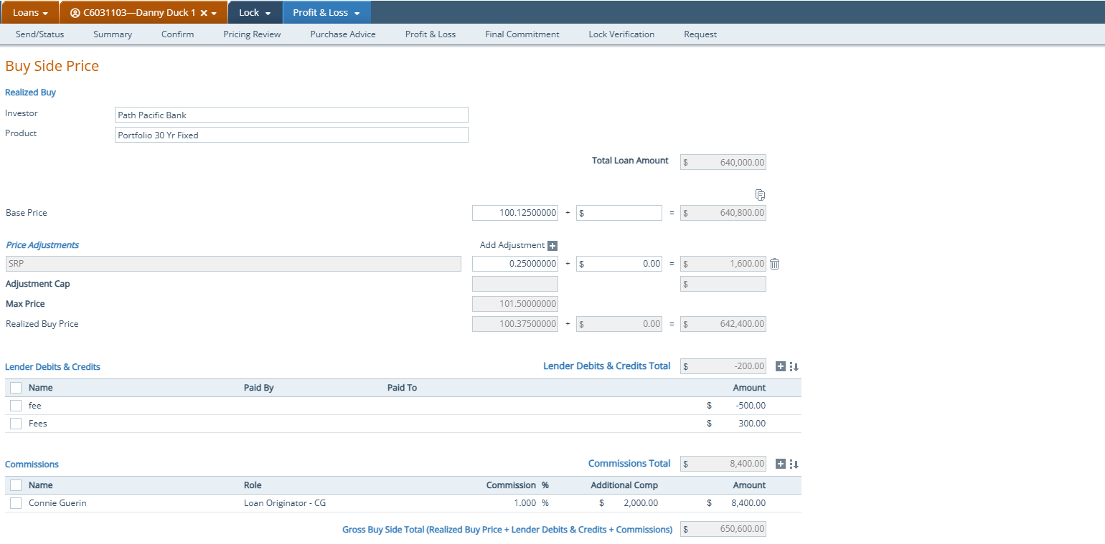
Profit & Loss Screen

Slide 23
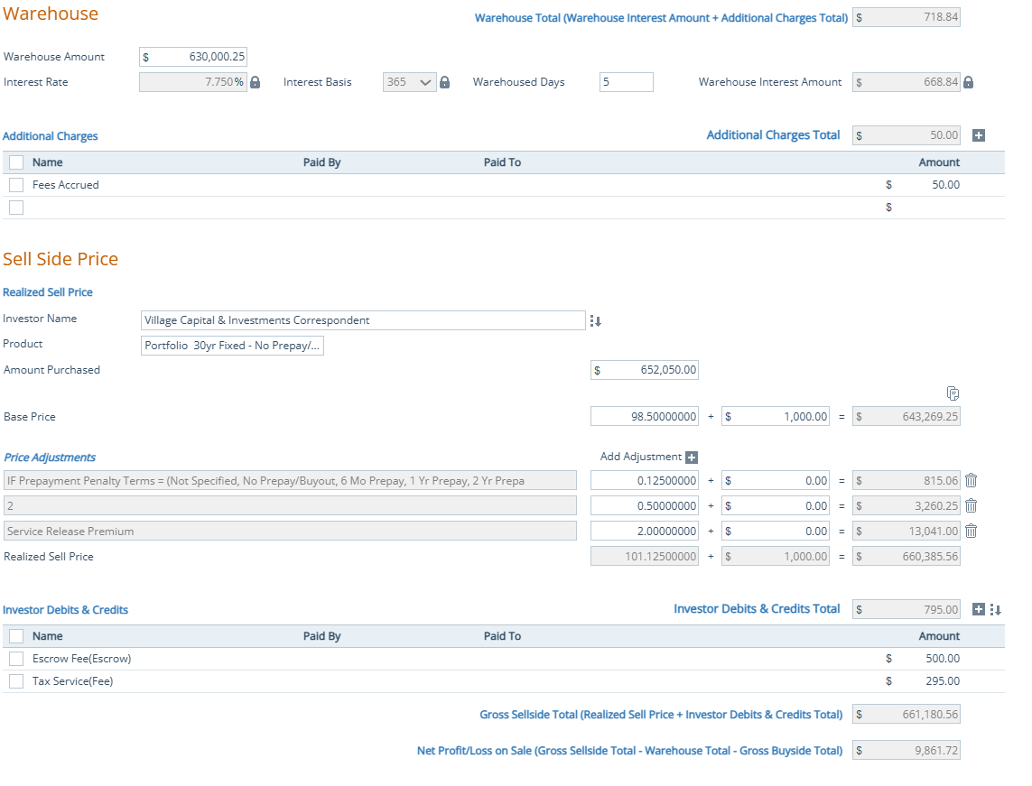
Profit and Loss screen

Slide 24

Thank You For Your Partnership
CALYX BLOOM 2026
Connie Guerin / Lee Tran

