Slide 1

Wholesale Lending & Calyx TPO
Geo Kang, Sung Park

Slide 2

Path and Geo Corp
Using Path since 2018
Very Active Wholesale Account
3,000 users, 600+ BU configured

Slide 3
Geo Corp
Founded in 1997
Licensed in 30 States and Washington DC
Outside of Geo-Corp’s headquarters, 5 additional retail branches
Wholesale channel
    Started in 2023
    Wholesale volume is now roughly 80% of our volume

Slide 4
Why Wholesale?
Simple Answer: Needed more volume
Quality control main concern
Maintain perfect track record vs. risk management
HUD Neighborhood Watch Compare Ratio

Slide 5
How We Got Here
Strong Operations team
Importance of process and workflow
Create an environment where staff focus on making decisions, not other tasks
Added new roles and offshore units

Slide 6
Why Path?
Encompass >> SMART >> Path
LOS Options
    Build own Platform
    Conform to software
    Configurable LOS
Path is highly configurable
    Blessing and a curse
Geo-Corp adopted Path in 2018 but only started to use it properly in mid 2021
    Used several platforms concurrently
    Paperless in 2022
Main objective is to stay in Path environment
    Vendor integrations and AI tools built in-house

Slide 7
The Transition
Geo-Corp strictly retail at initial setup
    Path allowed us to add wholesale channel
Different Roles allows for separate workflows
Different roles at the originating level converge at one junction point
Software isn’t the magic answer but Path makes it easier

Slide 8
Broker Challenges & Expectations
Easy and reliable platform for loan submission
Ability to search products and pricing
Request Rate lock capability
Real-time status updates and automated notifications

Slide 9
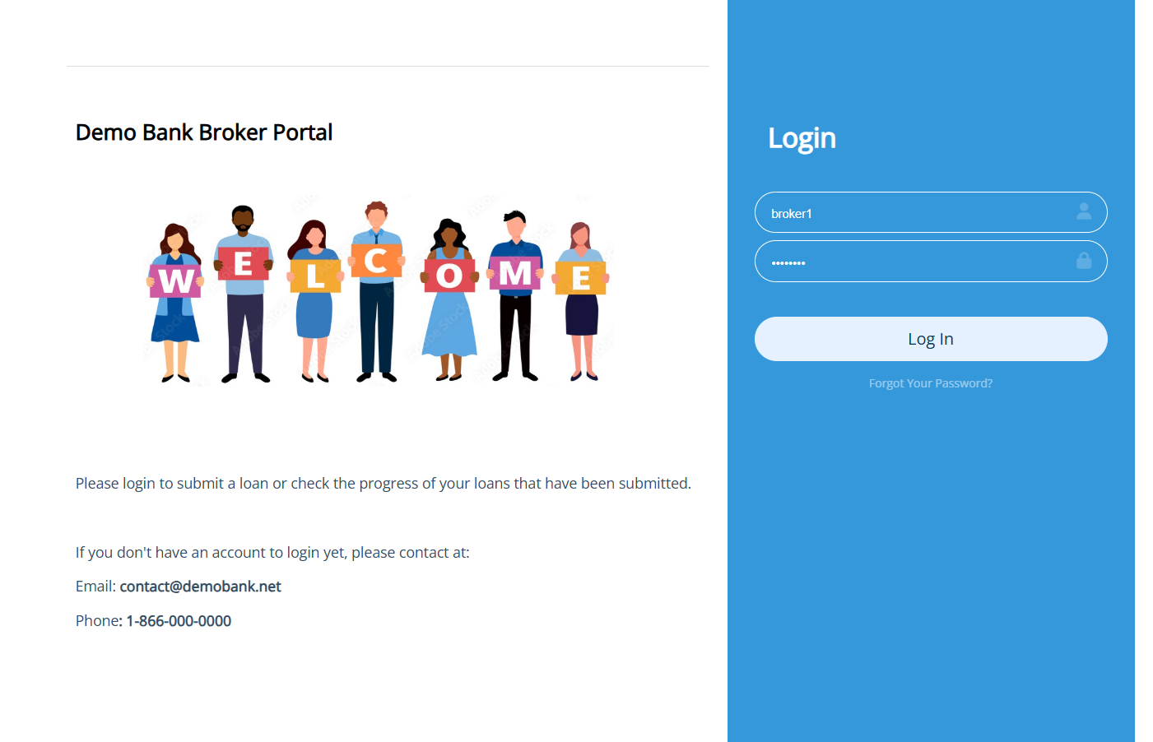
Calyx TPO – Broker Experience
yourcompany.calyxtpo.com
Built In, but still configurable
Branding your TPO portal

Slide 10
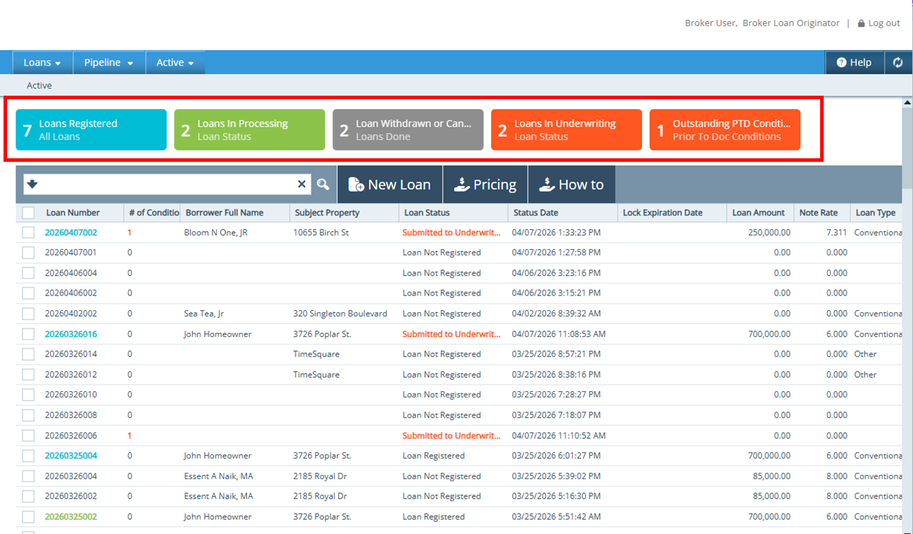
Calyx TPO
Dashboard for milestones and status

Slide 11
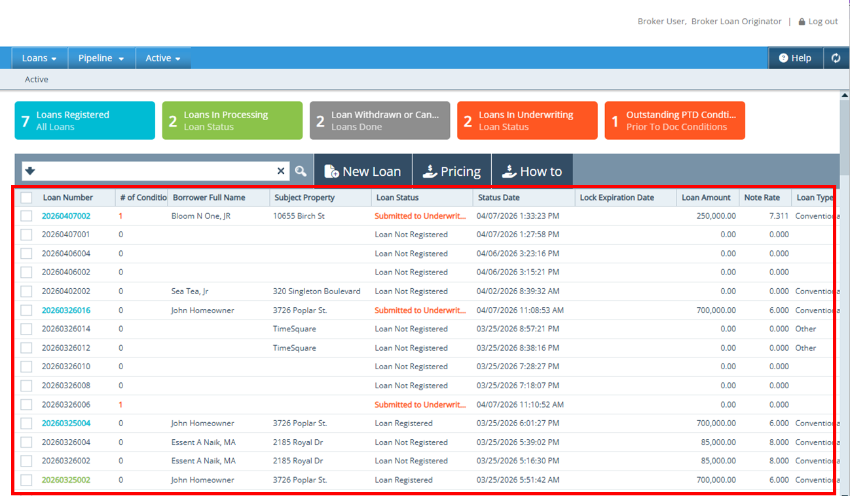
Calyx TPO – Broker Experience
Show milestones and status
Single Pipeline

Slide 12
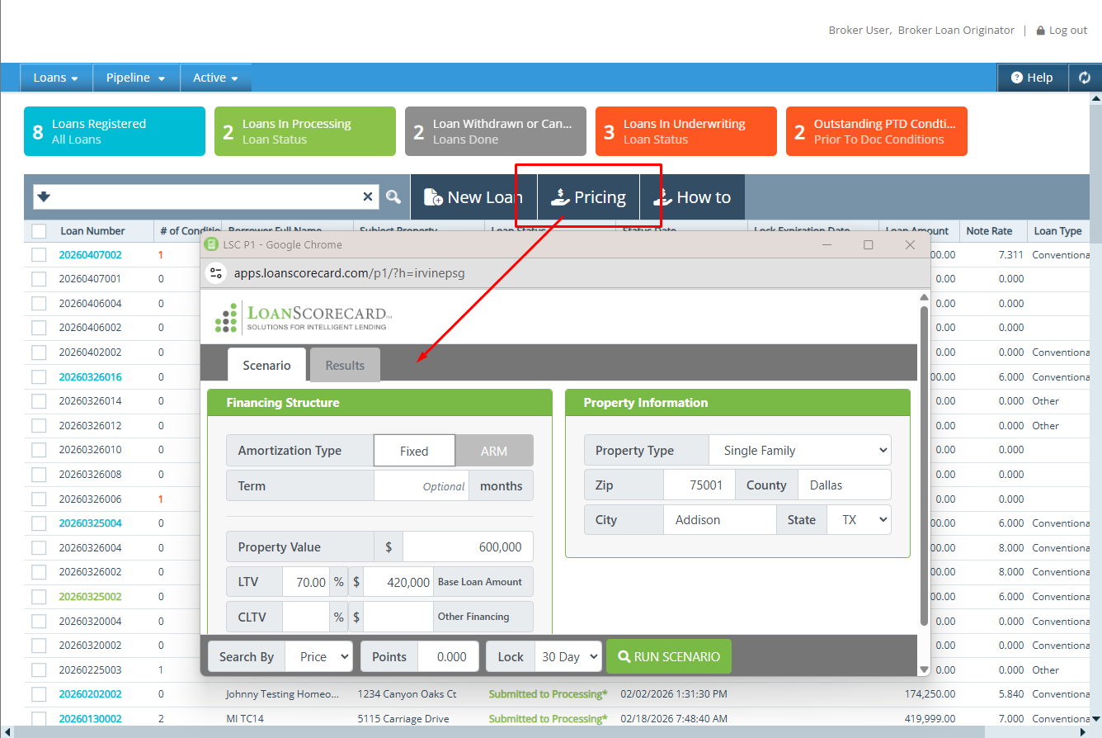
Calyx TPO – Broker Experience
Show milestones and status
Single Pipeline
Quick Product and Rate Search

Slide 13
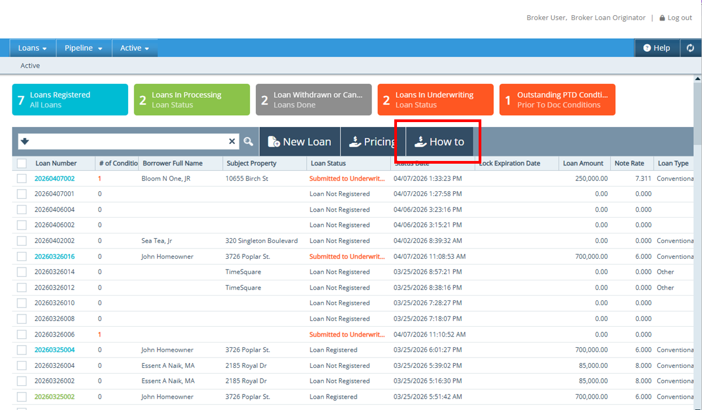
Calyx TPO – Broker Experience
Show milestones and status
Single Pipeline
Quick Product and Rate Search
Add your training materials

Slide 14
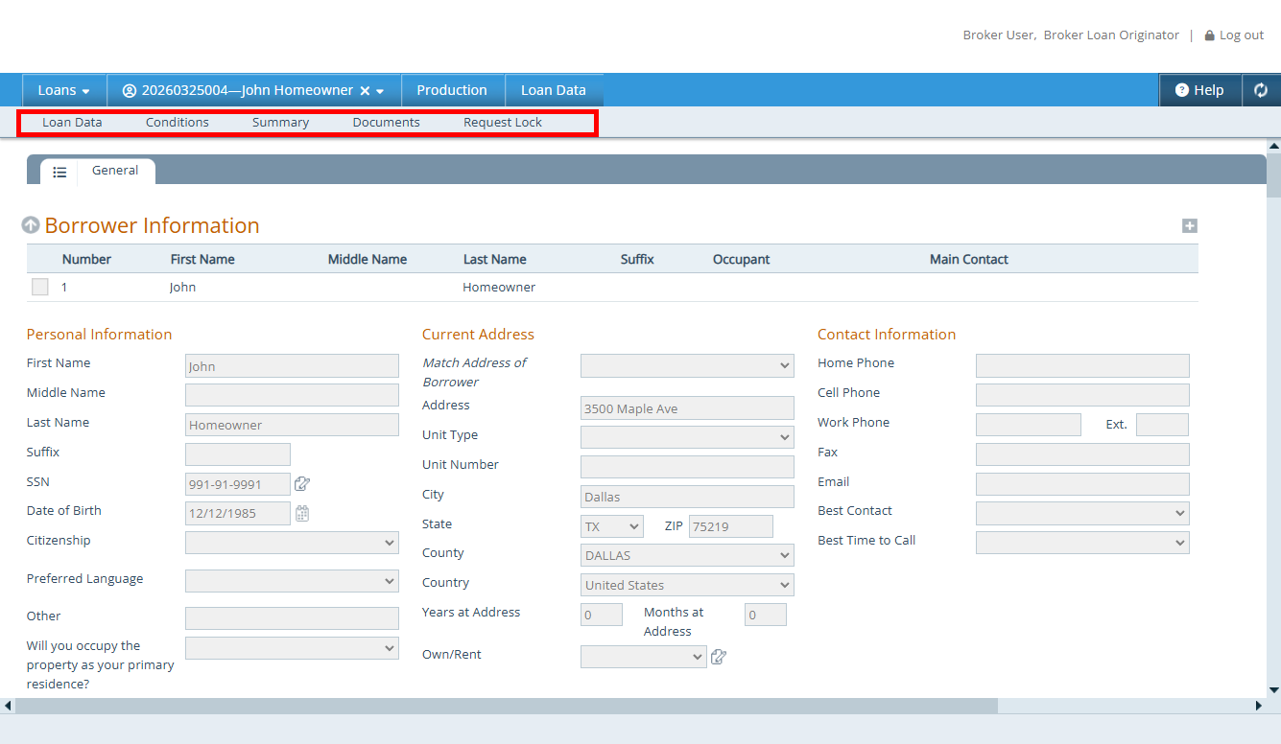
Calyx TPO – Broker Experience
Simply and Easy – Show what broker needs
  Screens
  Interfaces
Simple Screen Navigation
Submit and wait

Slide 15
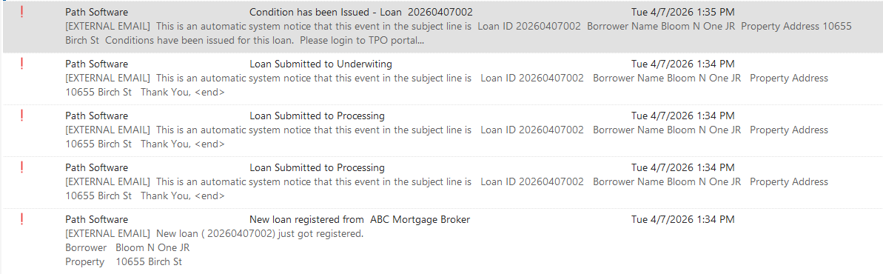
Calyx TPO – Broker Experience
Get Notified

Slide 16
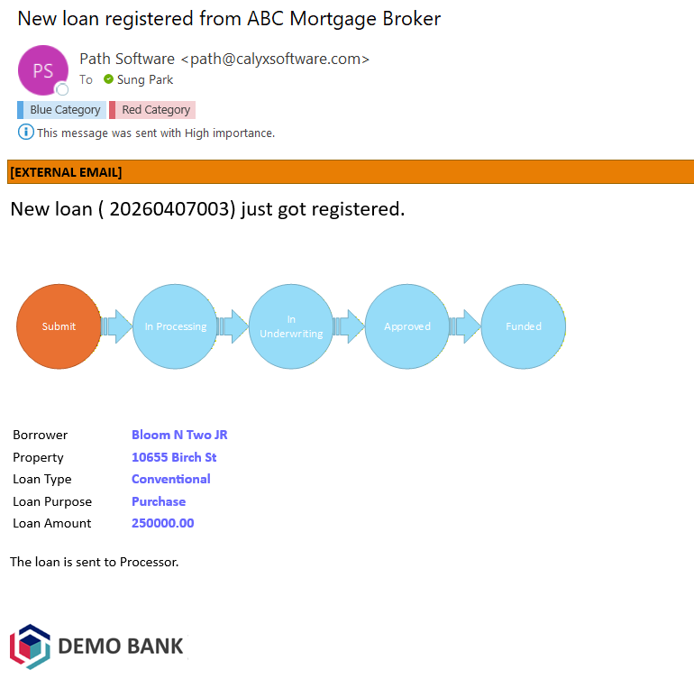
Calyx TPO – Broker Experience
Loan Registered

Slide 17
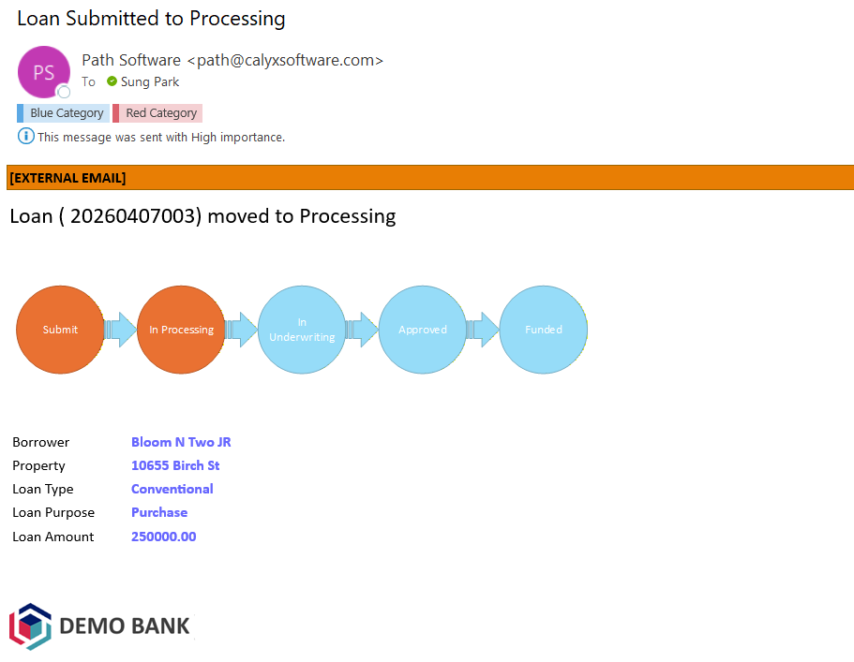
Calyx TPO – Broker Experience
Loan Registered
Loan in Processing

Slide 18
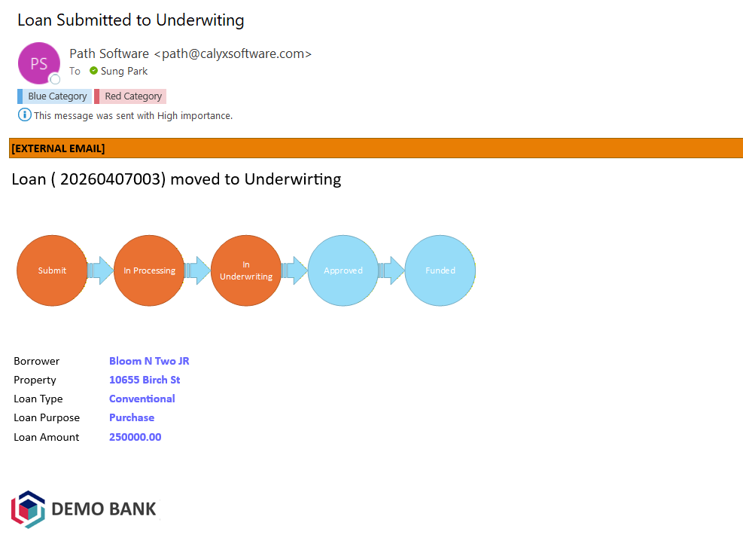
Calyx TPO – Broker Experience
Loan Registered
Loan in Processing
Loan in Underwriting

Slide 19
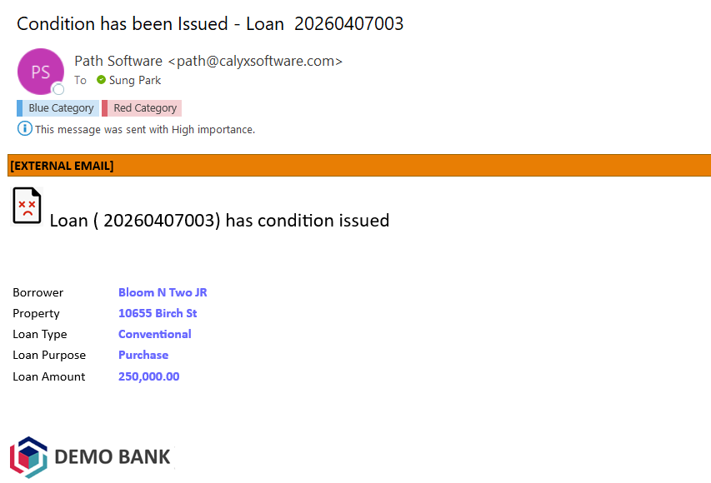
Calyx TPO – Broker Experience
Loan Registered
Loan in Processing
Loan in Underwriting
Condition Issued

Slide 20
Lenders Challenges
Broker onboarding and training
Submission support and document collection
Real-time communication and transparency
End-to-end process efficiency through closing
Simplified follow-up for AEs and AMs

Slide 21
How Calyx TPO solves Lender’s Challenges
Single platform with Path
  Single workflow for from TPO to Closing
  Data Integrity granted
Easily configurable by Lender
  TPO for brokers
  Lender for Processing

Slide 22
How Calyx TPO solves Lender’s Challenges
Calyx TPO
Part of Calyx Platform
  Link to other services
  Expose to CIC
    Bring more business
    60,000+ Point and Zenly users
    Post your programs
Pricing Engine
(LSC)
Calyx Industry Connect
Loan Analyzer
(LSC)
Calyx POS
Path
3rd Party
System

Slide 23
Calyx Platform
Calyx TPO
Pricing Engine
(LSC)
Loan Analyzer
(LSC)
Calyx Industry Connect
Path
Calyx POS
3rd Party
System

Slide 24

THANK YOU
Sung Park
866-302-2599
Sung_park@calyxsoftware.com
www.pathsoftware.com

